Slide 1
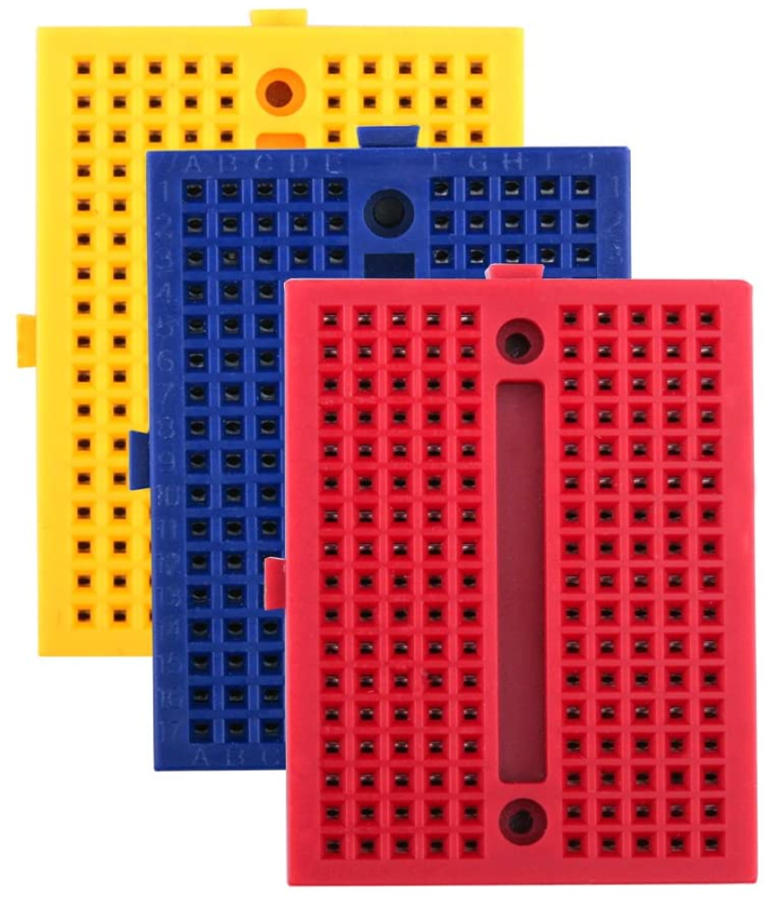
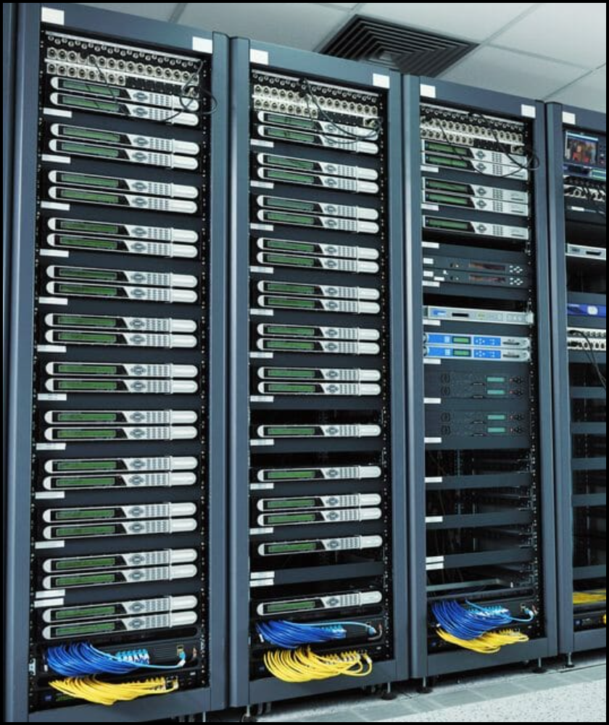

Centralized Temperature & Humidity Monitoring System for Server Racks
IoT with ESP32 Training
Rack 2
50 °C
60%
MODULE 2d
Rack 3
54 °C
70%
Rack 1
50 °C
60%
https://www.upsite.com/blog/sealing-rack-need/
IoT with ESP32 Training|Rev01-JAN2021|Loc/Date

Slide 2
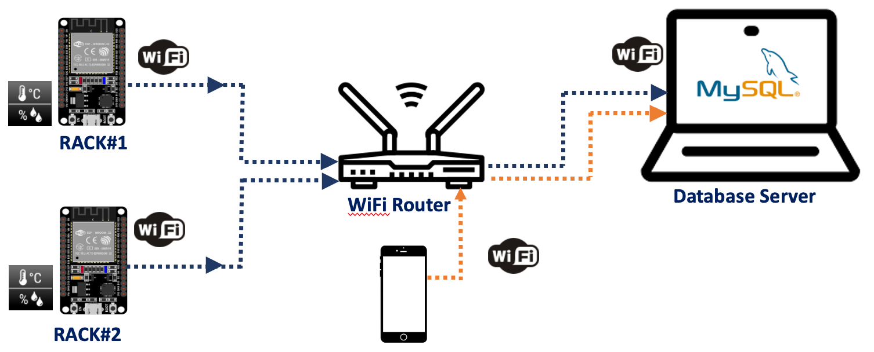
2d. Centralized Temperature & Humidity Monitoring System for Server Racks
Project Overview
This tutorial will teach how to save data from ESP32s (or any ethernet microcontrollers) into MySQL.
Scenario:
You are required to monitor 2 server racks in a data center; i.e., Rack#1 & Rack#2 by using 2 ESP32s and 2 DHT11 sensors. Both readings need to be saved into a single table. The temperature & humidity of both rooms can be monitored thru webpage.
ZXZXZ
Rev01 JAN2021

Slide 3


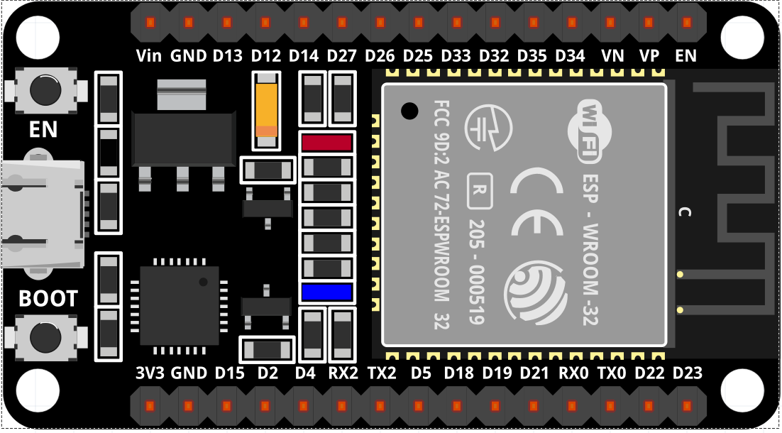
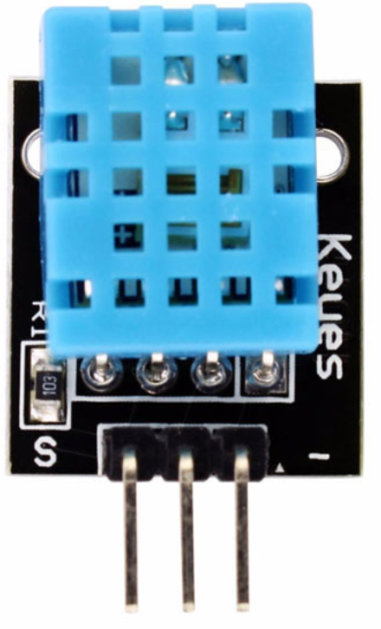


2d. Centralized Temperature & Humidity Monitoring System for Server Racks
Components
Hardware:
→ 1 x ESP-32 Wifi+Bluetooth 2-In-1 Development Board for Arduino (30 pin) + Cable.
→ 1 x Temperature & Humidity Sensor, DHT11.
→ Jumpers (male to female).
→ 2 x Mini Breadboard.
Software:
→ XAMPP ver 8.0.1(PHP 8.0.1) for Windows / OS X.
Rev01 JAN2021

Slide 4
2d. Centralized Temperature & Humidity Monitoring System for Server Racks
Solution
→ Step 1: Propose block diagram & flowcharts
A story board of the whole project which will give clear picture what you need to do.
→ Step 2: Install Apache Web Server
i. Install XAMPP (once), start web server service
ii. Start XAMPP service
iii. Test XAMPP page & PHPMyAdmin page
→ Step 3: Creating MySQL Database
i. Create database + test
ii. Create a PHP file for medium of transferring information from ESP32 to MySQL + Test
**Test with dummy data / manually inject data to database
→ Step 4: Preparing PHP script to insert data to MySQL database
i. Configure *.php scripts.
ii. PHP script to display database.
iii. HTTP GET & HTTP POST.
Rev01 JAN2021

Slide 5
2d. Centralized Temperature & Humidity Monitoring System for Server Racks
Solution
→ Step 4: Preparing PHP script to insert data to MySQL database
i. Configure esp_to_dbase.php file.
ii. PHP script to display database.
→ Step 2: Install XAMPP
i. Install XAMPP (once)
ii. Start XAMPP service
iii. Test XAMPP page & PHPMyAdmin page
→ Step 3: Creating MySQL Database
i. Create database + test
iii. Create a PHP file for medium of transferring information from ESP32 to MySQL + Test
**Test with dummy data / manually inject data to database
→ Step 3: x Temperature & Humidity Sensor, DHT11.
i. Construct circuit
ii.
→ Step 4: Integrate Step 1 & Step 2
i. Construct circuit
Rev01 JAN2021

Slide 6
2d. Centralized Temperature & Humidity Monitoring System for Server Racks
Solution: Step 1
PROPOSED BLOCK DIAGRAM & FLOWCHART
Project Block Diagram
ESP32
DHT11
Sensor
XAMPP Server
Router
Rev01 JAN2021

Slide 7
2d. Centralized Temperature & Humidity Monitoring System for Server Racks
Solution: Step 1
Start
Start
PROPOSED BLOCK DIAGRAM & FLOWCHART
Flowchart
F
Install & execute XAMPP
T
Initialize DHT11
Database: datacenters_ctivities
F
Table: room_dc230
T
F
Connect to WiFi
Fields: id, timeIndateIn, rackID, temp, humid, status
Insert Data Manually
T
F
Block Diagram
Microcontroller;
Input: Temperature, Humidity, RacklD
Success
Test .php by manually inject rackID, temp,humid & status into database
Fail
End
Success
End
Rev01 JAN2021

Slide 8
2d. Centralized Temperature & Humidity Monitoring System for Server Racks
Solution: Step 1
Start
Start
PROPOSED BLOCK DIAGRAM & FLOWCHART
Flowchart
F
Install & execute XAMPP
T
Initialize DHT11
Database: datacenters_ctivities
F
Table: room_dc230
T
F
Connect to WiFi
Fields: id, timeIndateIn, rackID, temp, humid, status
Insert Data Manually
T
F
Save data in MySQL
Success
Test .php by manually inject rackID, temp,humid & status into database
Fail
End
Success
End
Rev01 JAN2021

Slide 9
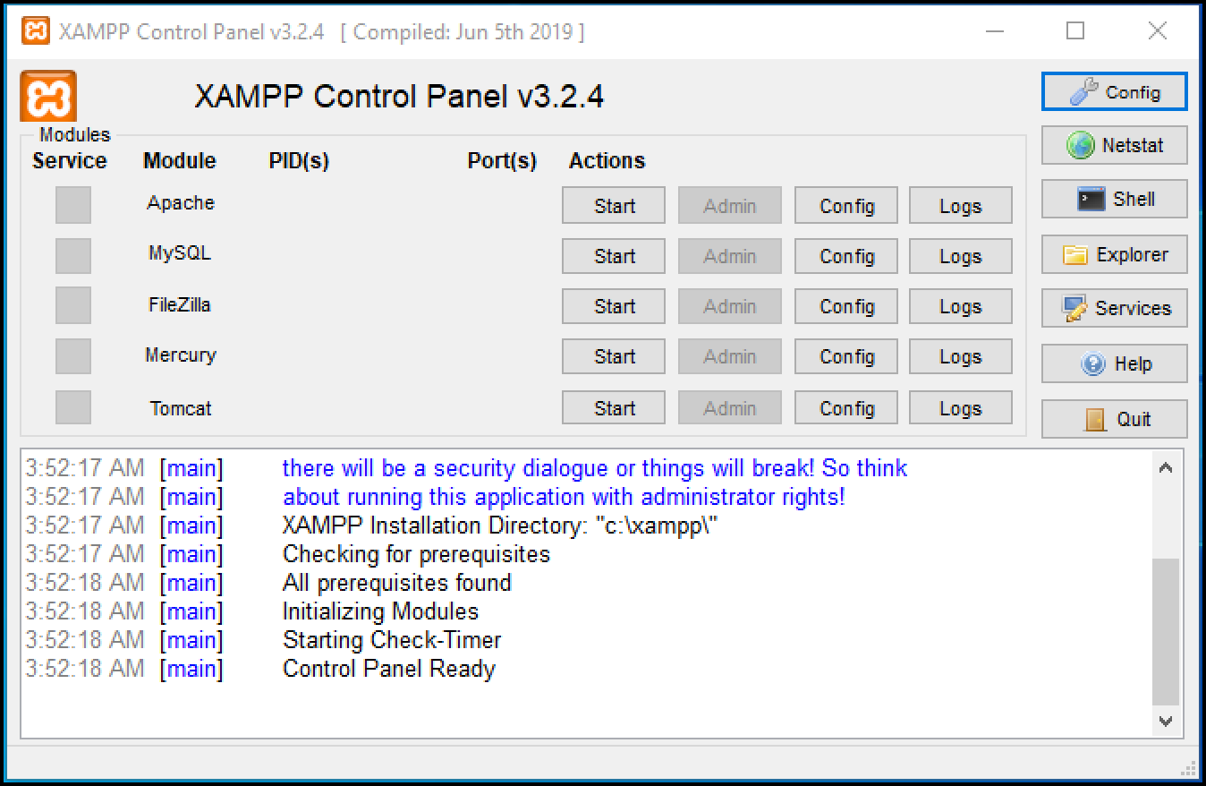
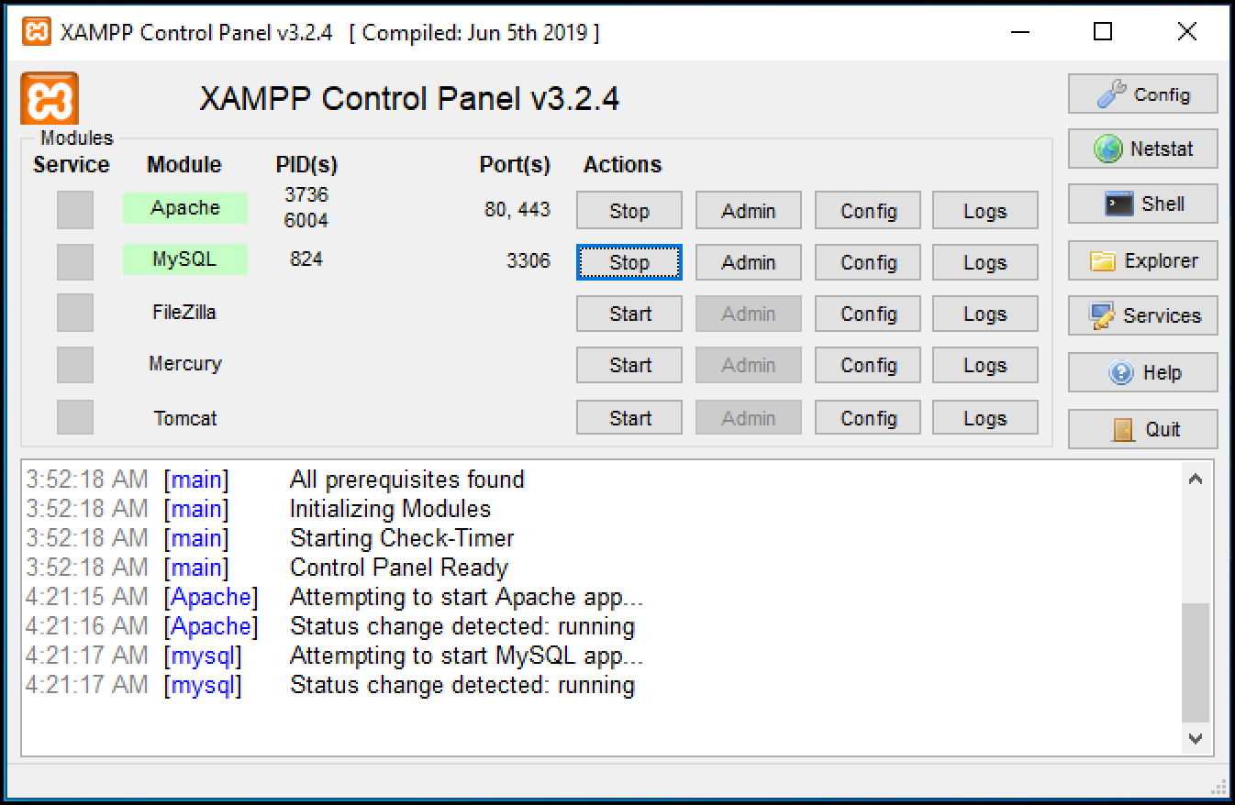
2d. Centralized Temperature & Humidity Monitoring System for Server Racks
Solution: Step 2
INSTALL, START & TEST XAMPP SERVICES
→ Download and install latest version of XAMPP from https://www.apachefriends.org/download.html
→ This link shows full tutorial on installing XAMPP on windows https://blog.templatetoaster.com/install-xampp-on-windows/
→ Once installed, launch XAMMP Control Panel (7.3.26)
For Windows (v7.3.26):
- to run, go to c://xampp/contol-control.exe → Start MySQL Database & Apache Web Service
- open your browser and type http://localhost/
Click START
SERVICE
STARTED
Rev01 JAN2021

Slide 10
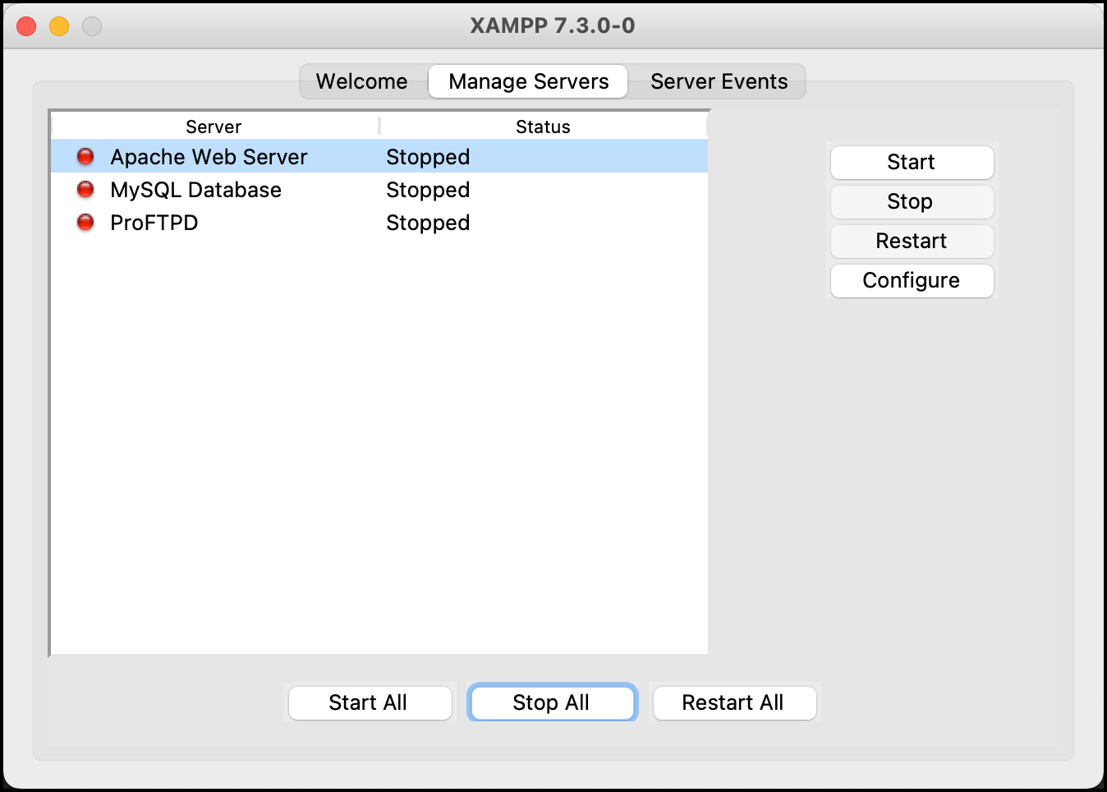

2d. Centralized Temperature & Humidity Monitoring System for Server Racks
Solution: Step 2
INSTALL, START & TEST XAMPP SERVICES
For OS X (v7.3.0):
- go to Applications>XAMPP>manager-osx → Start MySQL Database & Apache Web Service
- open your browser and type http://localhost/
Click START
SERVICE
STARTED
Rev01 JAN2021

Slide 11
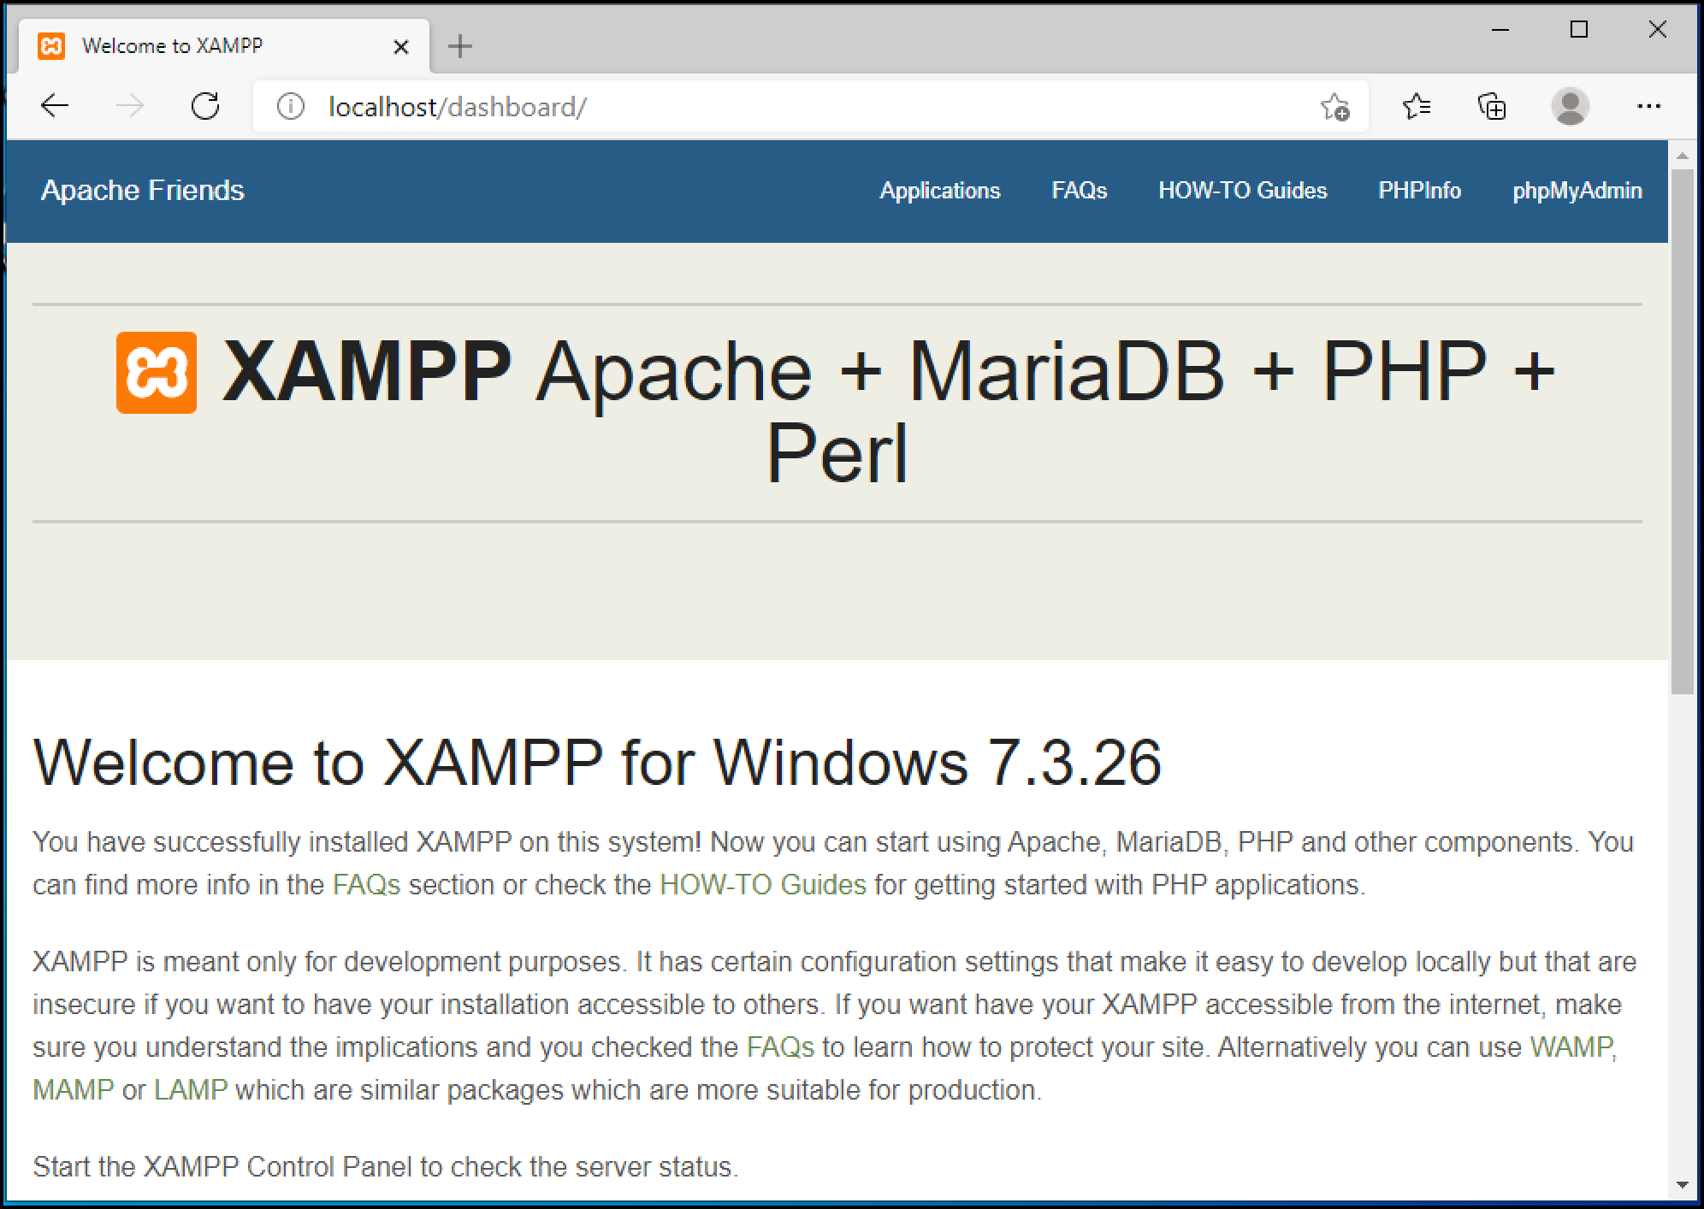
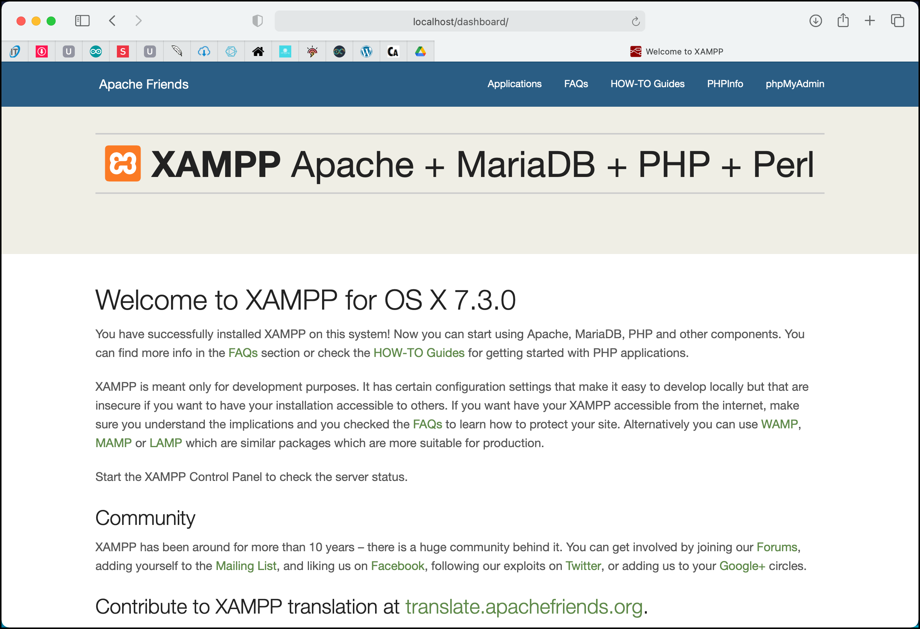
2d. Centralized Temperature & Humidity Monitoring System for Server Racks
Solution: Step 2
INSTALL, START & TEST XAMPP SERVICES
→ XAMPP landing page can be found at http://localhost/
Windows system
OS X system
Rev01 JAN2021

Slide 12
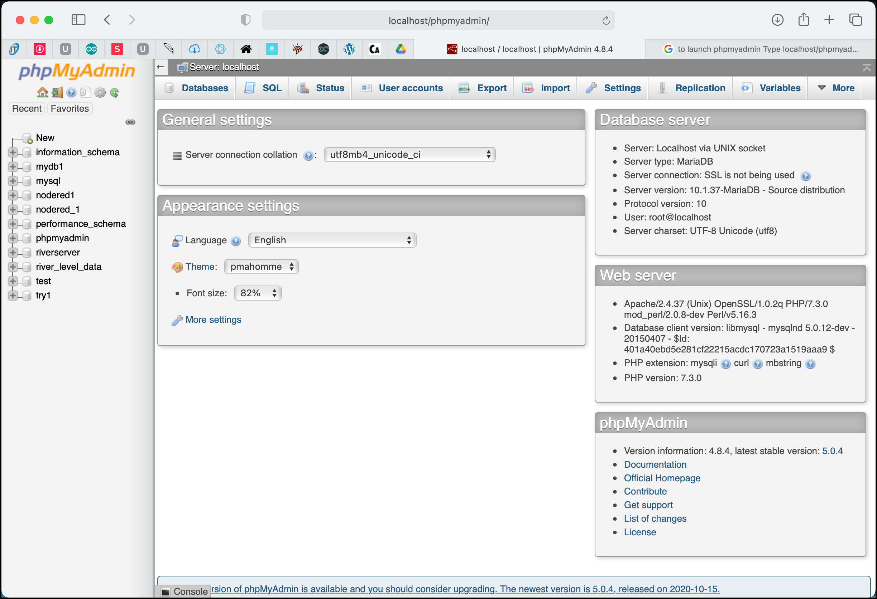
2d. Centralized Temperature & Humidity Monitoring System for Server Racks
Solution: Step 2
INSTALL, START & TEST XAMPP SERVICES
→ To use MySQL database, point your browser to http://localhost/phpmyadmin
→ You can also click phpMyAdmin link at XAMPP dashboard.
→ PHPMyAdmin is a third party tool to manage data inside the database.
Rev01 JAN2021

Slide 13
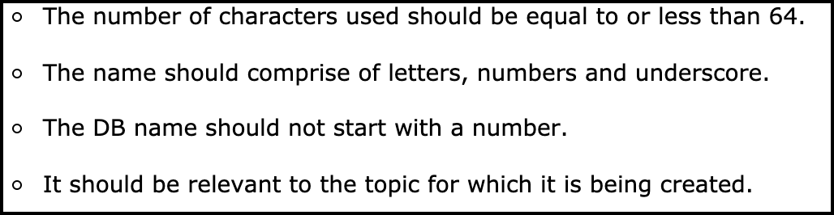
2d. Centralized Temperature & Humidity Monitoring System for Server Racks
Solution: Step 3
CREATING MySQL DATABASE
→ Set up database with the following properties:
Database Name: datacenter_activities
Table Name: room_dc230
Columns: 6
https://www.javatpoint.com/creating-mysql-database-with-xampp
NAME | TYPE | LENGTH | ADDITIONAL SETTING
id | INT | 11 | Index: PRIMARY AI: YES
logDateTime | DATETIME | - | Default: CURRENT_TIMESTAMP
rackID | VARCHAR | 255 | -
tempValue | VARCHAR | 255 | -
humidValue | VARCHAR | 255 | -
rackStatus | VARCHAR | 255 | -
AI = Auto Increment
- = empty
#use appropriate name for variables (dbname, tablename…) that reflect with the task/activity
Rev01 JAN2021

Slide 14
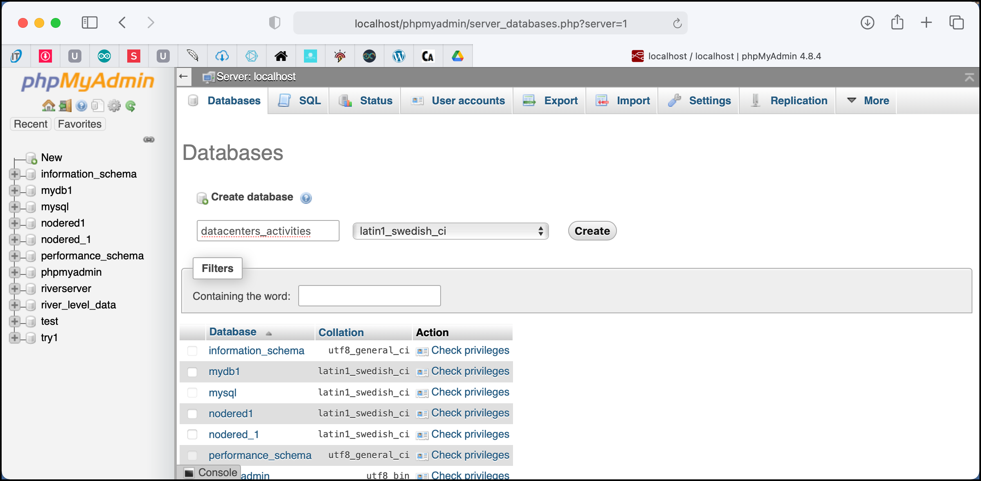
2d. Centralized Temperature & Humidity Monitoring System for Server Racks
Solution: Step 3
CREATING MySQL DATABASE
5
→ Database Name: datacenter_activities
6
1
1
2
3
Existing databases
Rev01 JAN2021

Slide 15
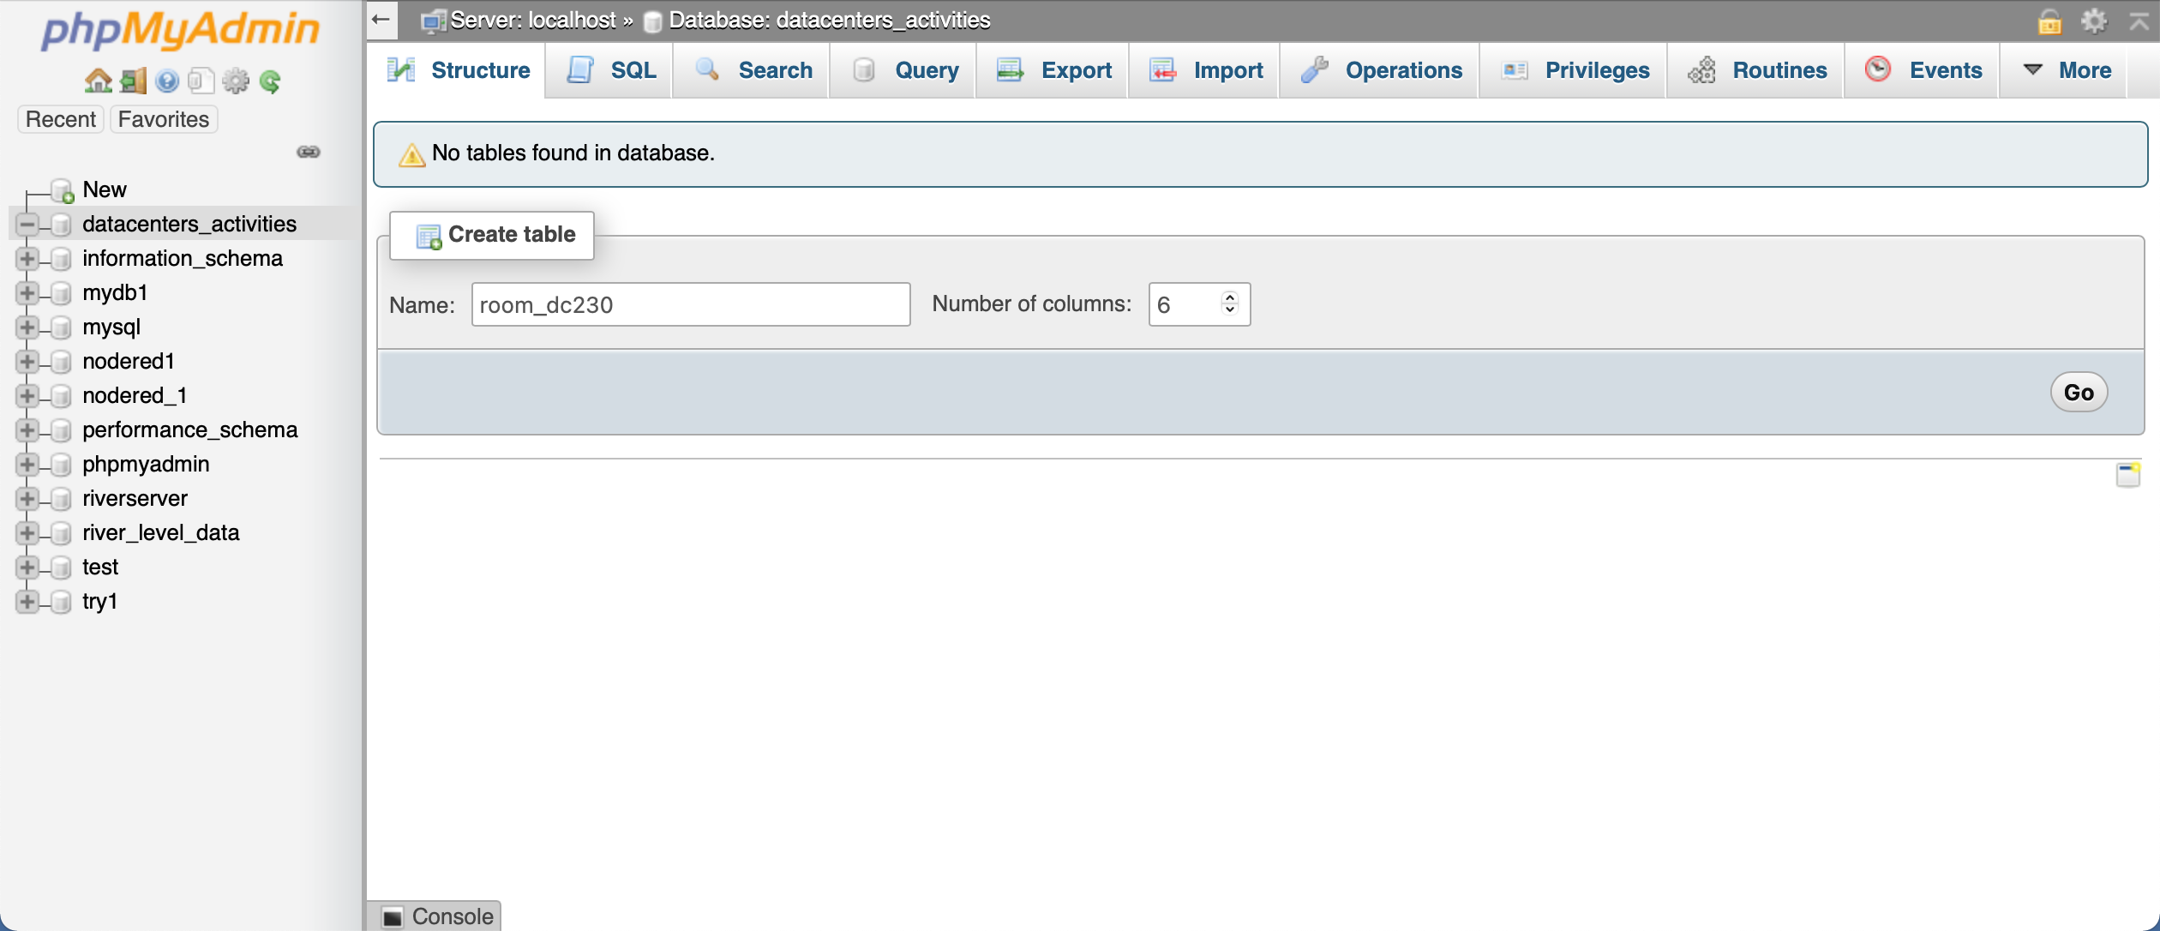
2d. Centralized Temperature & Humidity Monitoring System for Server Racks
Solution: Step 3
CREATING MySQL DATABASE
→ Table Name: room_ds230 Number of columns: 6
Just created
4
5
6
Rev01 JAN2021

Slide 16
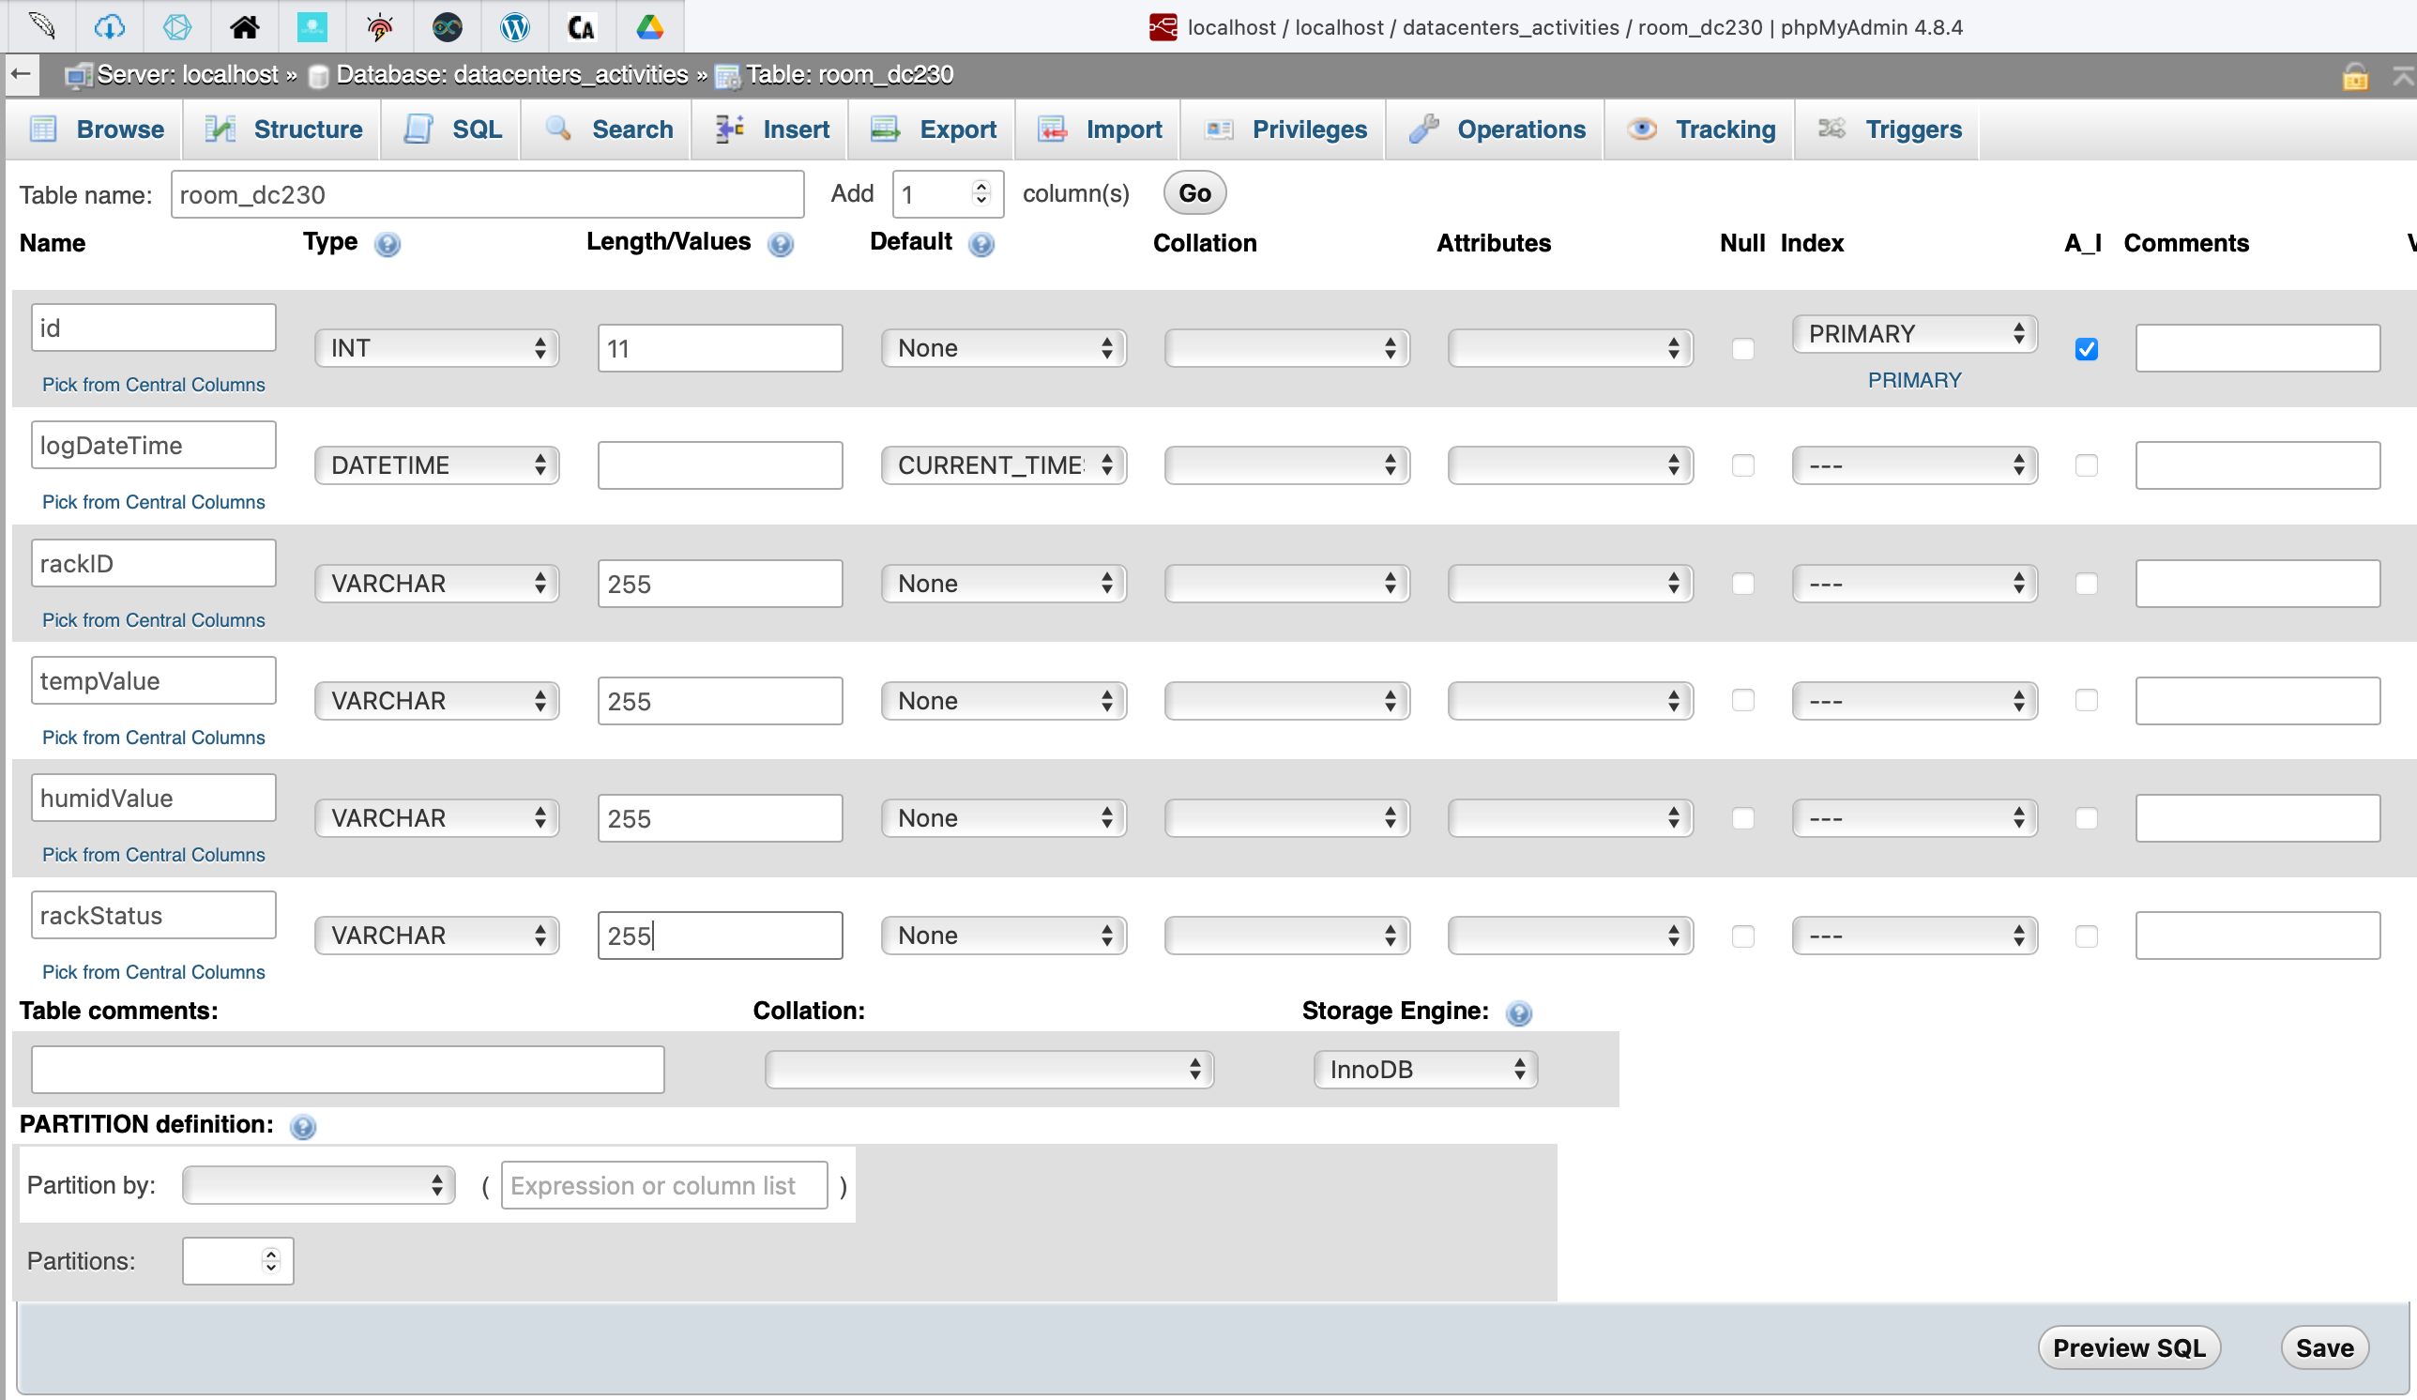
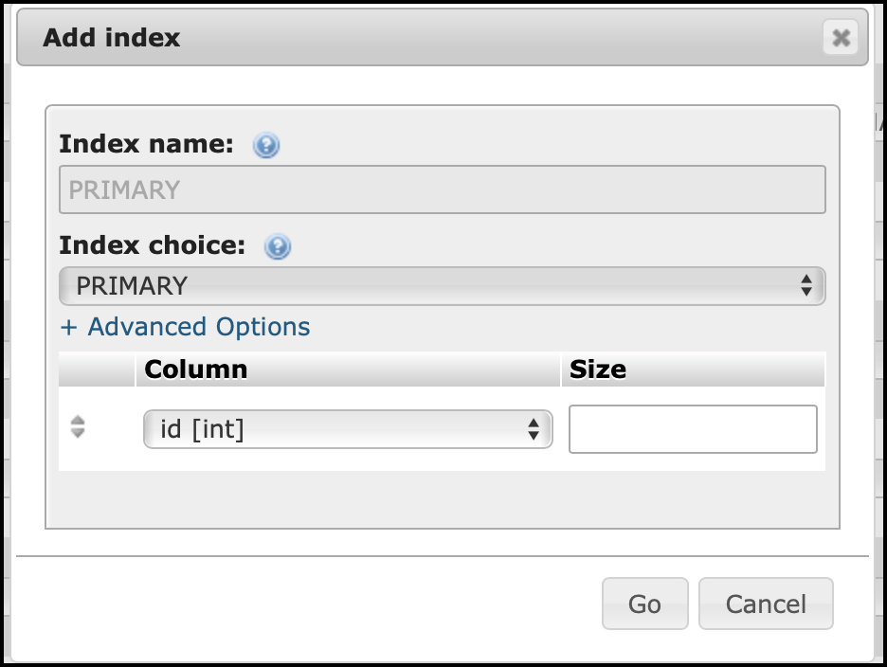
2d. Centralized Temperature & Humidity Monitoring System for Server Racks
Solution: Step 3
CREATING MySQL DATABASE
→ Table Name: room_ds230 Number of columns: 6
7
8
9
10
12
13
14
15
16
17
18
19
20
21
22
23
24
25
26
27
11
28
Rev01 JAN2021

Slide 17
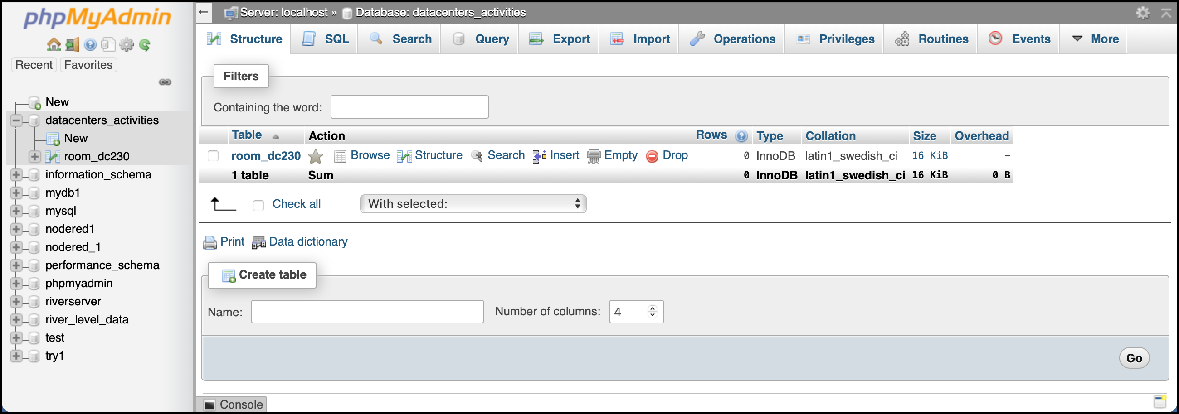
2d. Centralized Temperature & Humidity Monitoring System for Server Racks
Solution: Step 3
CREATING MySQL DATABASE
→ What you should know on PHPMyAdmin panel (at least).
b
a
b
c
d
e
Browse → to view / edit / delete data stored in room_dc230, increment counter will proceed to next number.
Structure → to view / edit / delete / add table structure.
Insert → to manually insert data into room_dc230.
Empty → to empty room_dc230 database, any increment counter will start from 1.
Drop → will delete room_dc230 table.
Rev01 JAN2021

Slide 18
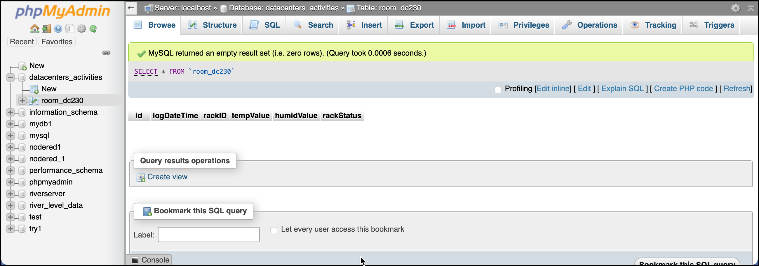
2d. Centralized Temperature & Humidity Monitoring System for Server Racks
Solution: Step 3
CREATING MySQL DATABASE
→ Click Browse to view room_dc230 database. It is empty since no data in it.
a
a
b
c
An empty database
Rev01 JAN2021

Slide 19
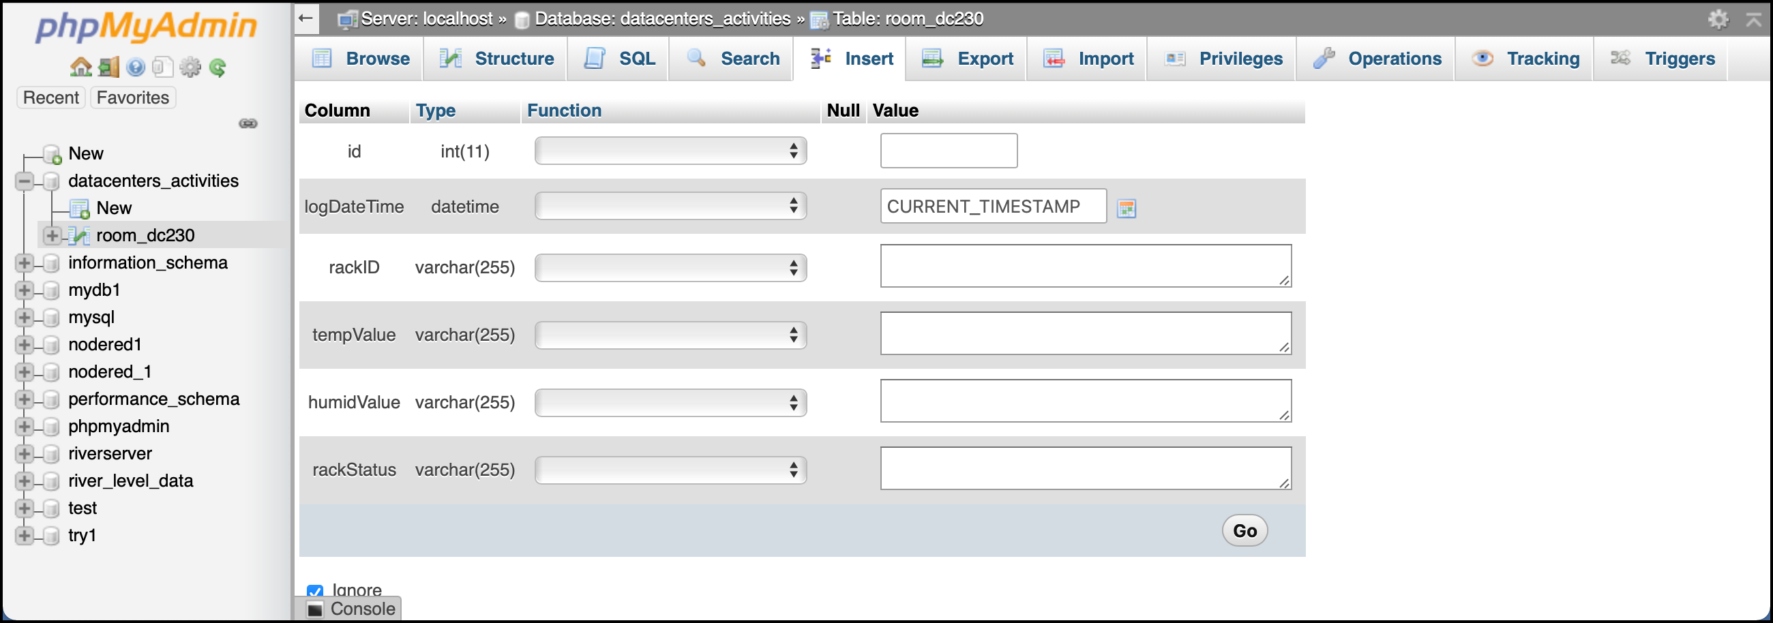
2d. Centralized Temperature & Humidity Monitoring System for Server Racks
Solution: Step 3
CREATING MySQL DATABASE
→ In order to insert data manually into room_dc230, select Insert.
→ For this time, leave ALL text box empty. Then click Go to save into room_dc230 database.
c
Rev01 JAN2021

Slide 20
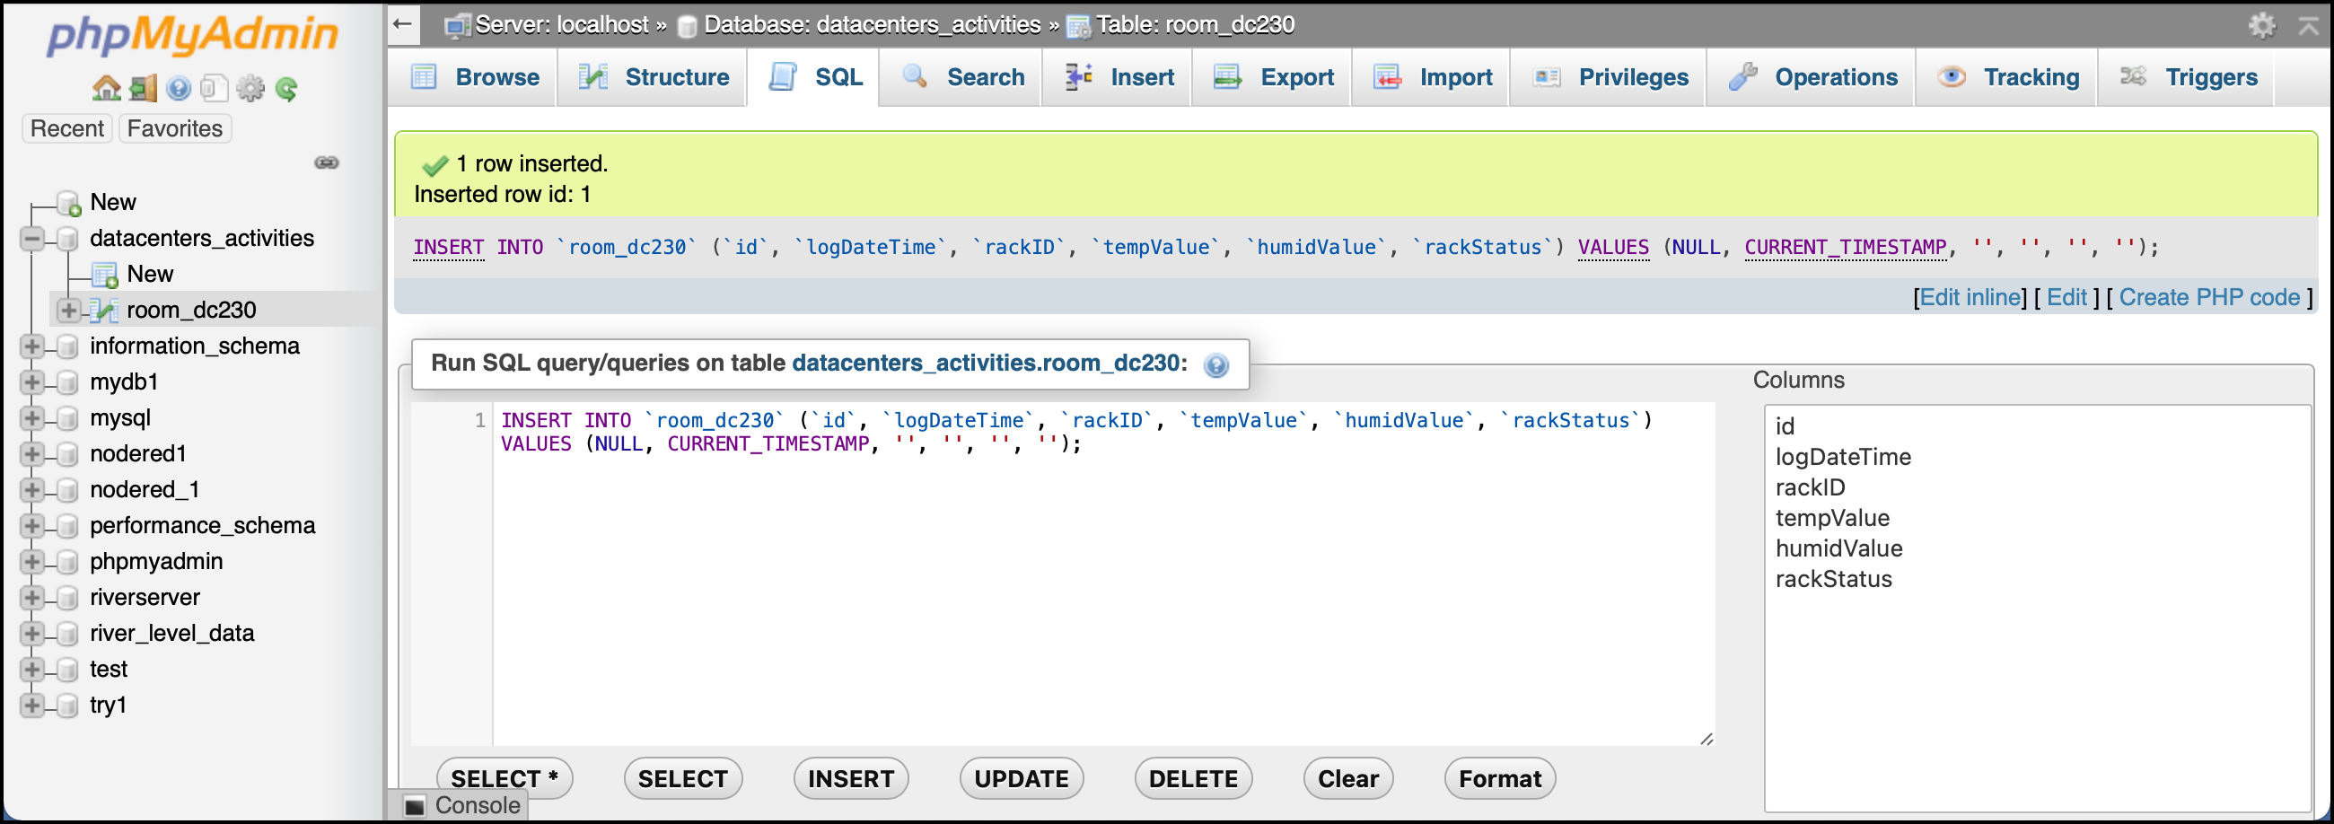
2d. Centralized Temperature & Humidity Monitoring System for Server Racks
Solution: Step 3
CREATING MySQL DATABASE
→ Observe the red arrow. What do you think?
→ Click Browse link to view the input.
a
a
Blank data inserted into rackID, tempValue, humidValue & rackStatus
Rev01 JAN2021

Slide 21
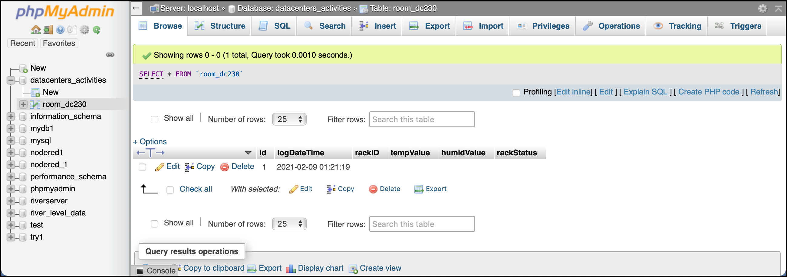
2d. Centralized Temperature & Humidity Monitoring System for Server Racks
Solution: Step 3
CREATING MySQL DATABASE
→ Congrats! You managed to add your first data into room_dc230 database.
→ Click Edit link if you wish to edit the data.
→ Delete will not reset the id into zero. Next data entered will get the following running number.
a
Rev01 JAN2021

Slide 22
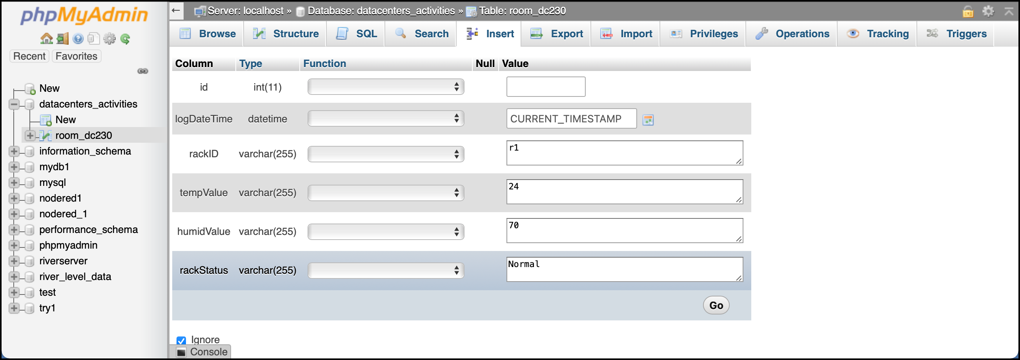
2d. Centralized Temperature & Humidity Monitoring System for Server Racks
Solution: Step 3
CREATING MySQL DATABASE
→ Go to Insert link and add the information as show by red arrow & press Go to save the data.
1
2
3
4
5
Rev01 JAN2021

Slide 23
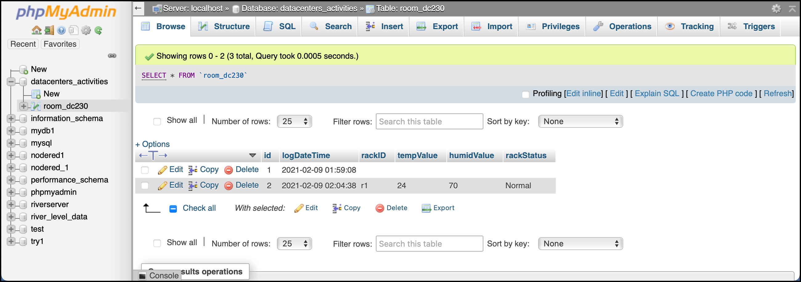
2d. Centralized Temperature & Humidity Monitoring System for Server Racks
Solution: Step 3
CREATING MySQL DATABASE
→ Red arrow shows the new data that have been entered.
Rev01 JAN2021

Slide 24

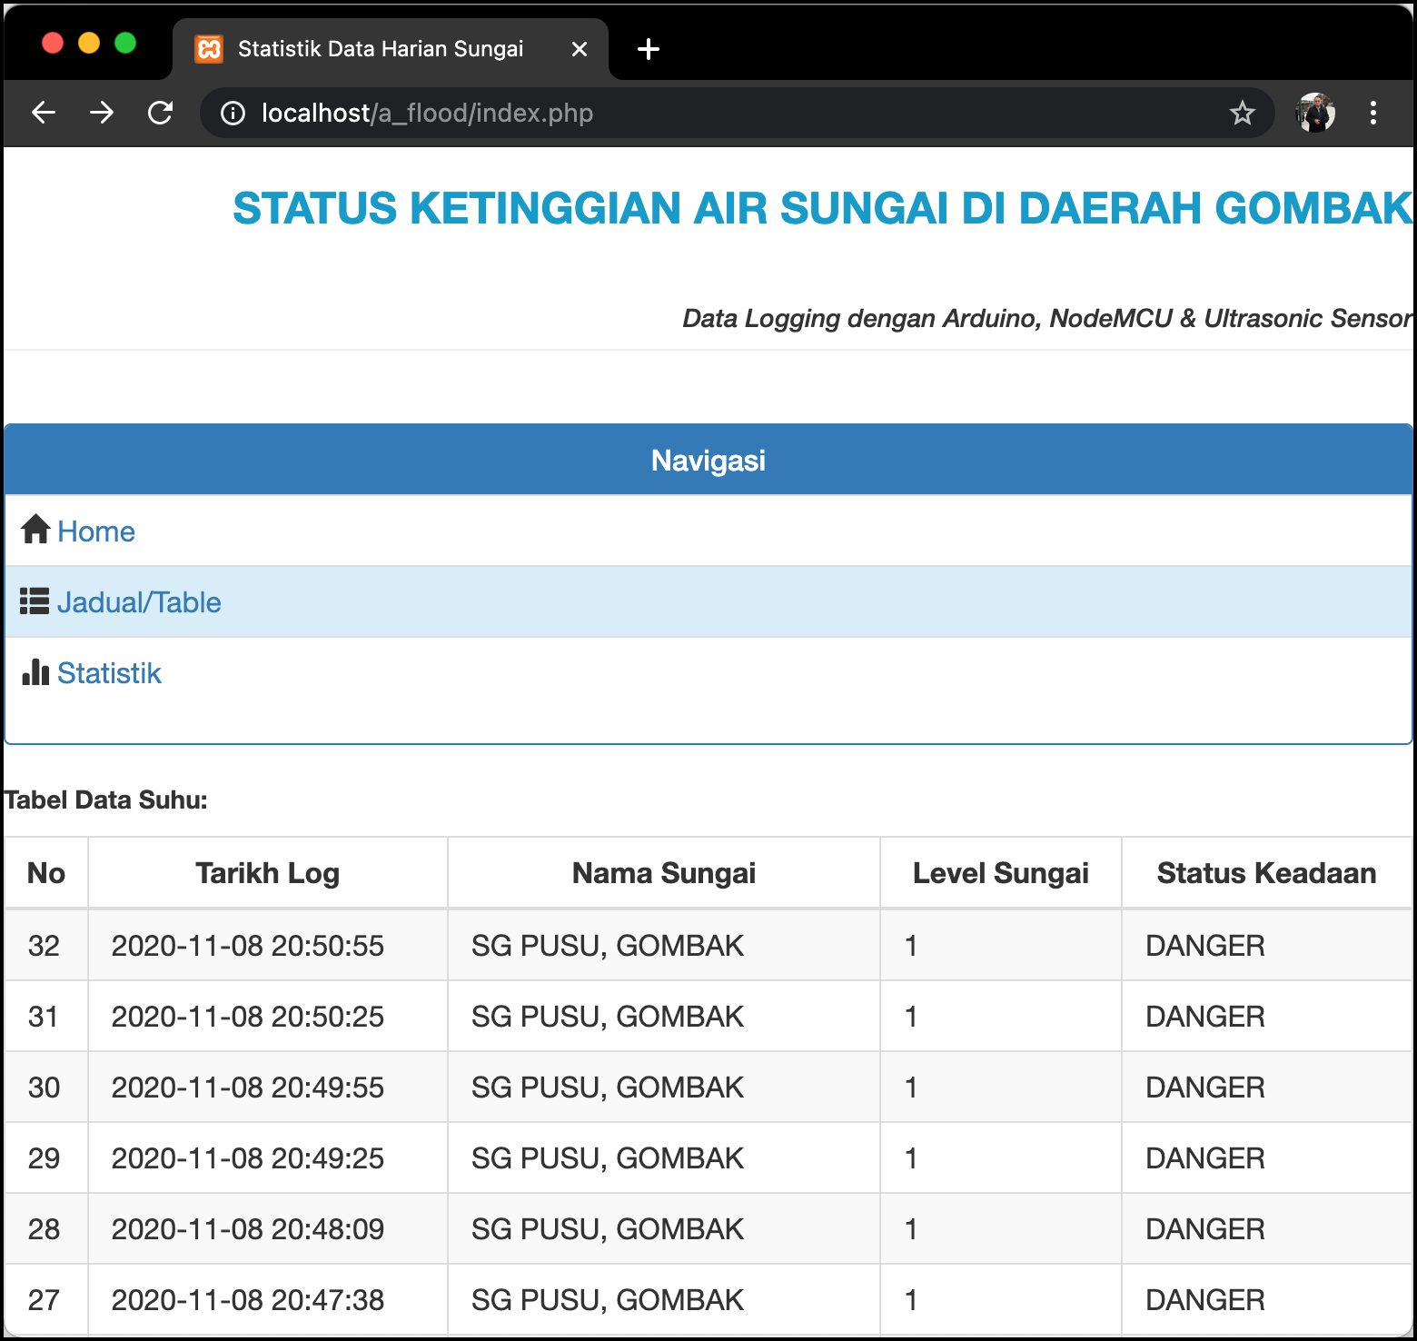

2d. Centralized Temperature & Humidity Monitoring System for Server Racks
Solution: Step 4
PHP SCRIPTS & HTDOCS & CODE EXPLAINATION & RUN TEST
→ Two PHP files are needed; esptodb.php & webview.php.
ESP32 + DHT11
...
HTTP POST
http://localhost/a-my/esptodb.php
ESP32 + DHT11
Send every xx seconds
Insert racks’ information into database table
http://localhost/a-my/webview.php
Publish information upon web request
Database: datacenters_activities
Table: room_dc230
Update every xx seconds
**esptodb.php is the medium of ESP32 to save information from racks into database
** webview.php is to display datacenters activities on web page.
Rev01 JAN2021

Slide 25
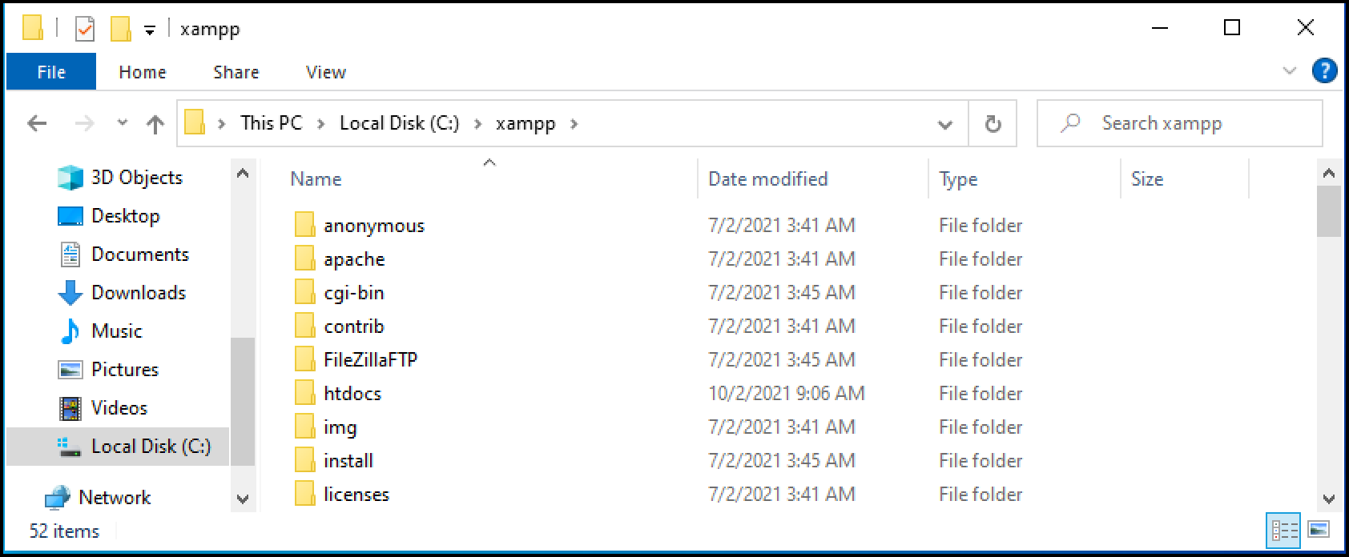
2d. Centralized Temperature & Humidity Monitoring System for Server Racks
Solution: Step 4
PHP SCRIPTS & HTDOCS & CODE EXPLAINATION & RUN TEST
→ In order to publish any website either PHP or HTML, you need to save the files in a specific folder, named htdocs. It can be found in XAMPP folder.
→ It is advised that each project has its own folder. This may avoid you to override files that carries same filename.
1
2
Rev01 JAN2021

Slide 26
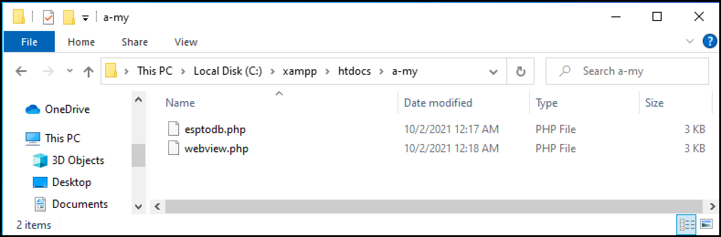
2d. Centralized Temperature & Humidity Monitoring System for Server Racks
Solution: Step 4
PHP SCRIPTS & HTDOCS & CODE EXPLAINATION & RUN TEST
→ Navigate to htdocs & create new folder named a-my.
Rev01 JAN2021

Slide 27
2d. Centralized Temperature & Humidity Monitoring System for Server Racks
Solution: Step 4
PHP SCRIPTS & HTDOCS & CODE EXPLAINATION & RUN TEST
→ Download “esptodb.php“ & “webview.php” from http://bit.ly/3p2pmNd.
→ Extract & paste the files into a-my folder.
→ ESP32 will use “esptodb.php“ as a medium to save information into MySQL while client will use “webview.php” to view the information thru web browsers.
Rev01 JAN2021

Slide 28
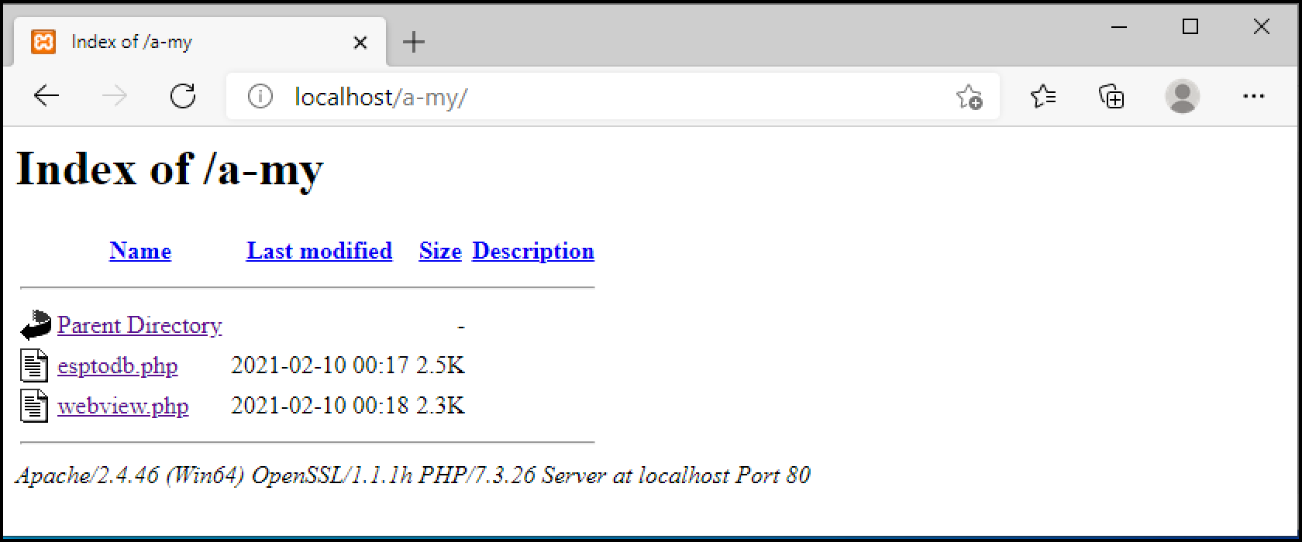
2d. Centralized Temperature & Humidity Monitoring System for Server Racks
Solution: Step 4
PHP SCRIPTS & HTDOCS & CODE EXPLAINATION & RUN TEST
→ Open up your web browser & type localhost/a-my/ in the address bar. You should get the similar output. If you failed to see this, go to your XAMPP C-Panel & check whether the server services has been deployed or not.
Rev01 JAN2021

Slide 29
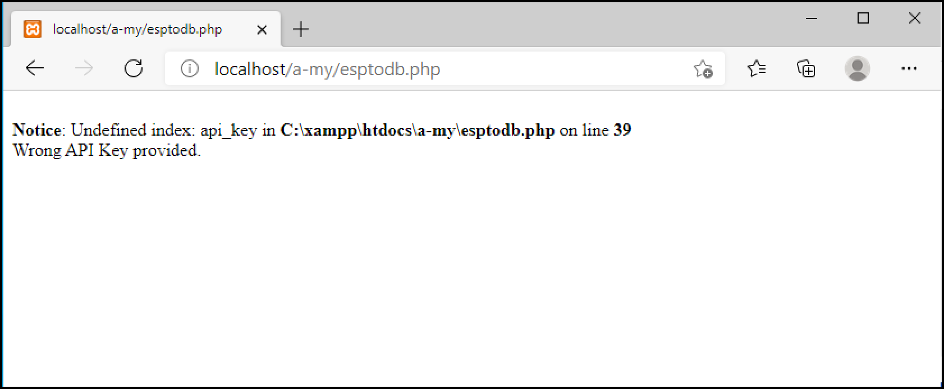
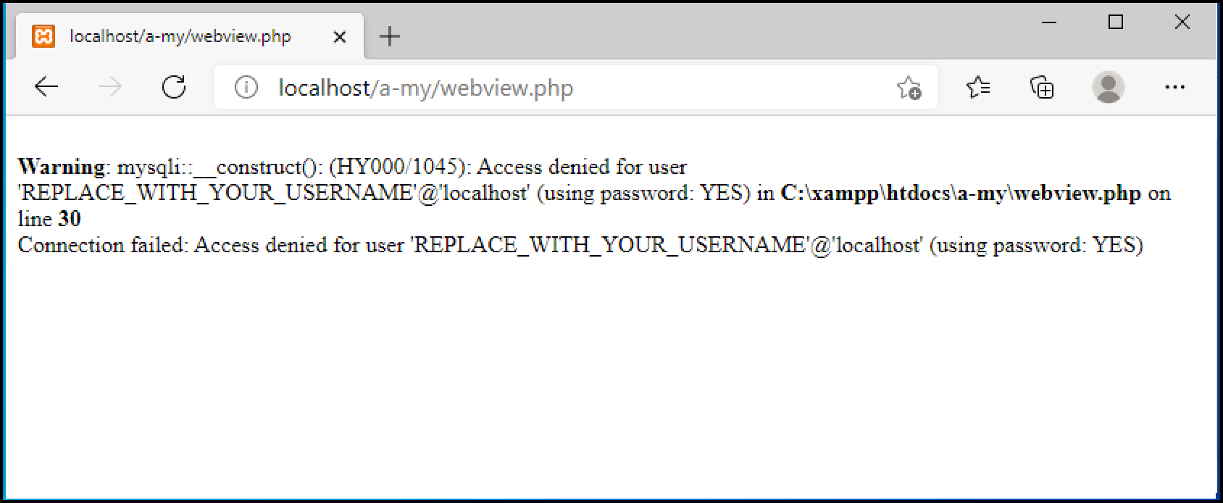
2d. Centralized Temperature & Humidity Monitoring System for Server Racks
Solution: Step 4
PHP SCRIPTS & HTDOCS & CODE EXPLAINATION & RUN TEST
→ Click at the file one at a time. There are errors/warnings since the files were not properly configure.
→ You need a text editor to edit both files & we are going to use Sublime Text as the editor for PHP scripts. You may download it the following link: https://www.sublimetext.com/3
Rev01 JAN2021

Slide 30
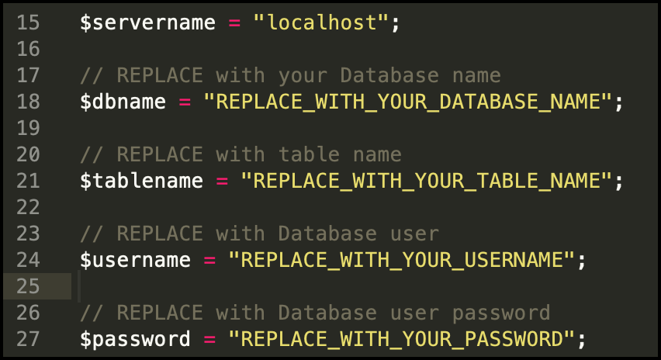
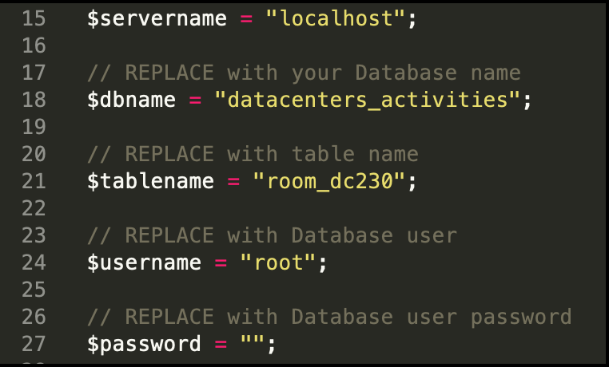
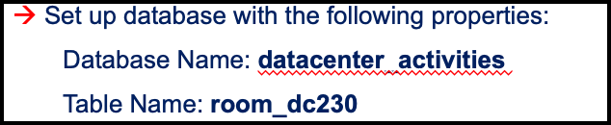
2d. Centralized Temperature & Humidity Monitoring System for Server Racks
Solution: Step 4
PHP SCRIPTS & HTDOCS & CODE EXPLAINATION & RUN TEST
→ Open webview.php with sublimetext or any preferable text editor. The credentials are to establish connection to the database.
→ By default, $servername is “localhost” & $username is “root”.
Rev01 JAN2021

Slide 31
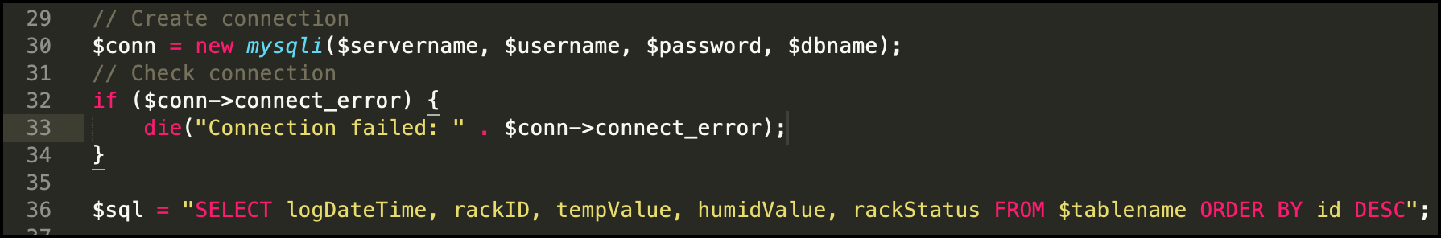
2d. Centralized Temperature & Humidity Monitoring System for Server Racks
Solution: Step 4
PHP SCRIPTS & HTDOCS & CODE EXPLAINATION & RUN TEST
→ Before getting access to MySQL database, the client must establish a connection to the server as shown in Line#30. If any of the credentials incorrect, the client don’t have the permission to access the server. The script stops & will display error message at the browser. (MySQLi = MySQL improved)
→ Line#36 indicates selection of 5 columns from room_dc230 table with descending order of id. The syntax is put into a variable called $sql.
Rev01 JAN2021

Slide 32
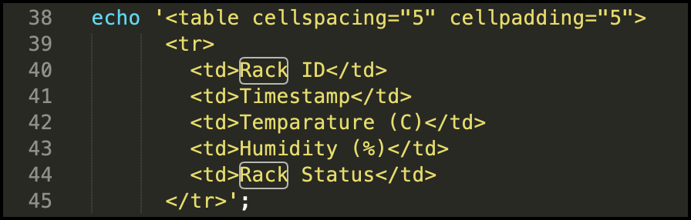
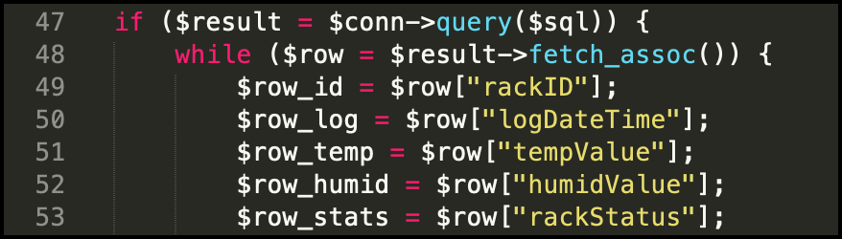
2d. Centralized Temperature & Humidity Monitoring System for Server Racks
Solution: Step 4
PHP SCRIPTS & HTDOCS & CODE EXPLAINATION & RUN TEST
→ A mix of PHP and HTML syntax in creating table.
→ Line#47 – Line#69 is hosting asking, fetch data from database & display them in table manner.
→”query( )” is a function that fetch data that was assigned in $sql variable. The results were put into a variable called $results.
→ each data from ”$results” will be split into an array form according to its respected field.
Rev01 JAN2021

Slide 33
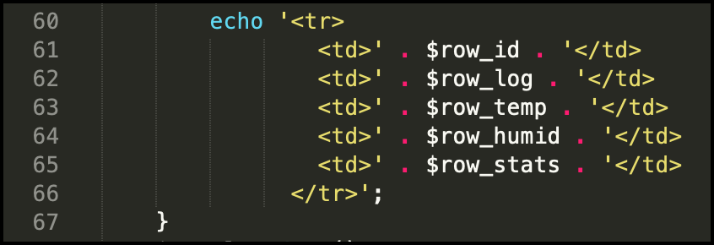
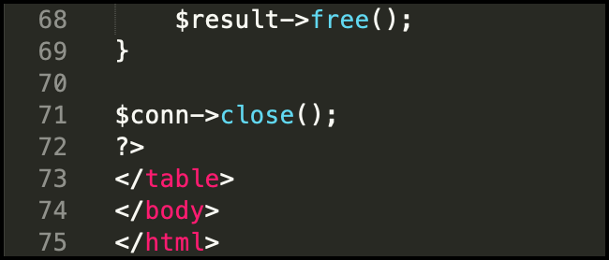
2d. Centralized Temperature & Humidity Monitoring System for Server Racks
Solution: Step 4
PHP SCRIPTS & HTDOCS & CODE EXPLAINATION & RUN TEST
→ Script to display the information fetched from database in table form. Each row represent 1 set data / reading. New row carries another set of reading/data.
→ The fetched data in $result are emptied, thus the variable carries no information.
→ ”close( )” is a function that closes previously open database connection.
→ End of HTML script.
Rev01 JAN2021

Slide 34
2d. Centralized Temperature & Humidity Monitoring System for Server Racks
Solution: Step 4
PHP SCRIPTS & HTDOCS & CODE EXPLAINATION & RUN TEST
→ Open esptodb.php with sublimetext or any preferable text editor. Fill up with your database credentials.
→ If webview.php is meant for client to view the temperature & humidity of the racks, esptodb.php is a script for EPS32 saving the racks data into the database.
→ $api_key_value is a kind of password to except information send from the ESP32. ESP32 must send same key & the information will only be entertained when the key is matched. Otherwise, the information will be rejected.
→ Line#33 will empty the content of the handlers. The task of the handlers are to keep for information temporarily when received from the ESP32 thru HTTP POST or HTTP GET request.
Rev01 JAN2021

Slide 35
(With HTTP POST, data is not visible in the URL request. However, if it’s not encrypted, it’s still visible in the request body.)
2d. Centralized Temperature & Humidity Monitoring System for Server Racks
Solution: Step 4
PHP SCRIPTS & HTDOCS & CODE EXPLAINATION & RUN TEST
→ There are 2 types of Hyper Text Transfer Protocol (HTTP) request methods: POST & GET.
→ What is HTTP? HTTP works as request-response protocol between a client & a server.
→ HTTP GET is used to request data from a specified resource. It is often used to get values form APIs.
- eg., http://localhost/esptodb.php?key=“tPmAT5Ab3jF9&temp=10
- Name = Key & value = tPmAT5Ab3jF9 + name = temp & value = 10 are send together in URL
- With HTPP GET, data is visible to everyone
→ HTTP POST is used to send information to a server to create/update a resource.
- eg., publish sensor readings to a server
- The data sent to the server with POST is stored in the request body of the HTTP request
- String serverPath = serverName "?temperature=24.37"; // sample in sketch
- With HTTP POST, data is not visible in the URL request. However, if it’s not encrypted, it’s still visible in the request body.
https://randomnerdtutorials.com/esp8266-nodemcu-http-get-post-arduino/
Rev01 JAN2021

Slide 36
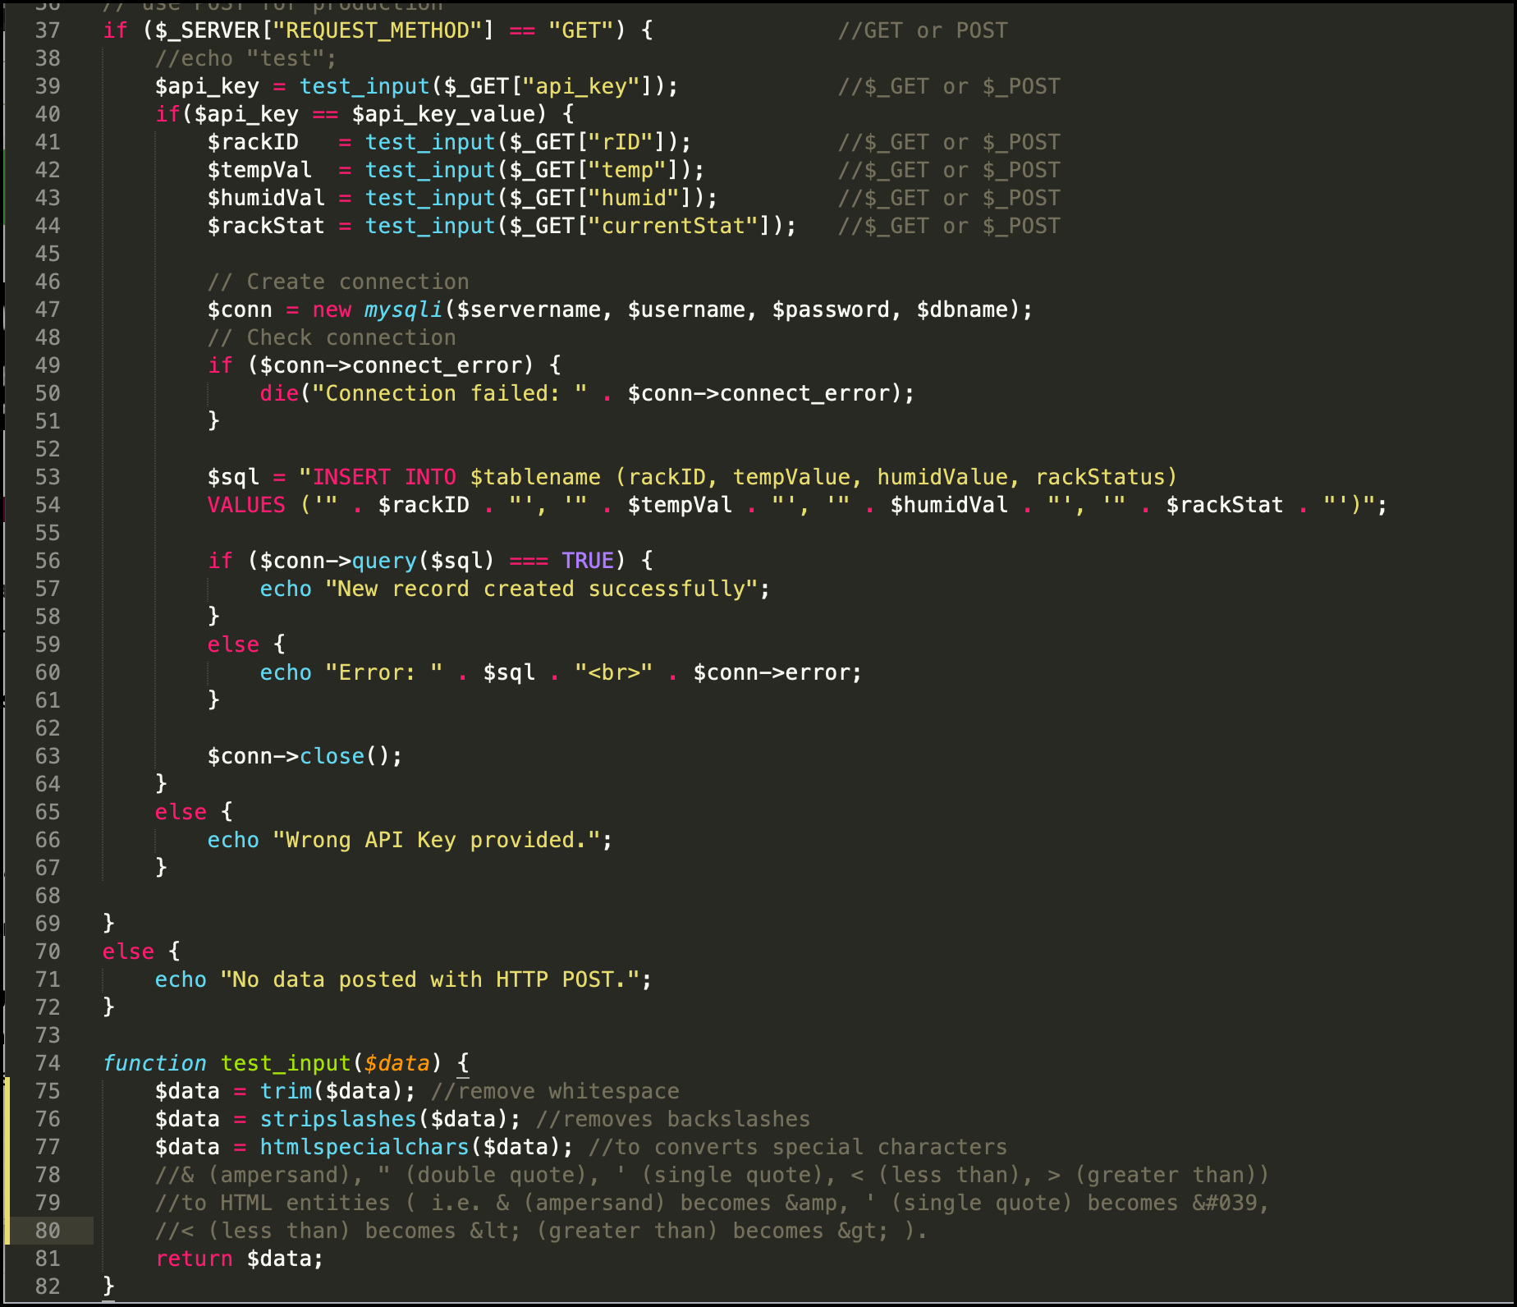
2d. Centralized Temperature & Humidity Monitoring System for Server Racks
Solution: Step 4
PHP SCRIPTS & HTDOCS & CODE EXPLAINATION & RUN TEST
a
http://localhost/a-my/esptodbase.php?api_key=tPmAT5Ab3j7F9&rID=v112&temp=22&humid=40&currentStat=NORMAL
a
Rev01 JAN2021

Slide 37
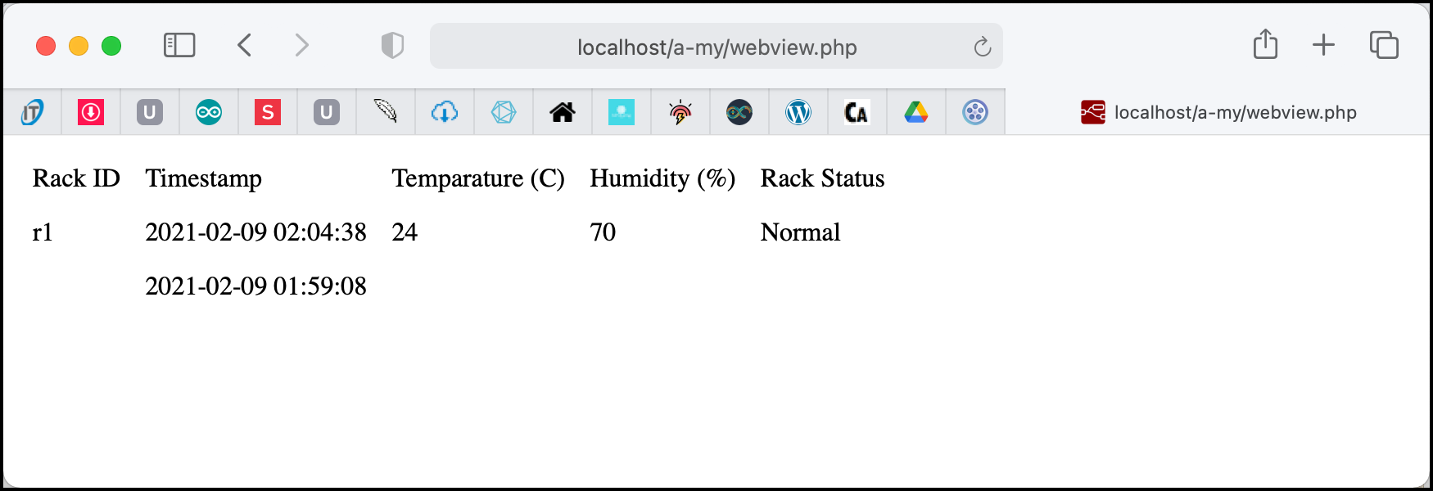
2d. Centralized Temperature & Humidity Monitoring System for Server Racks
Solution: Step 4
PHP SCRIPTS & HTDOCS & CODE EXPLAINATION & RUN TEST
→ It is now the time to test both PHP scripts. Make sure that the database credentials have set accordingly.
→ No information print out since the database is still empty.
Rev01 JAN2021

Slide 38
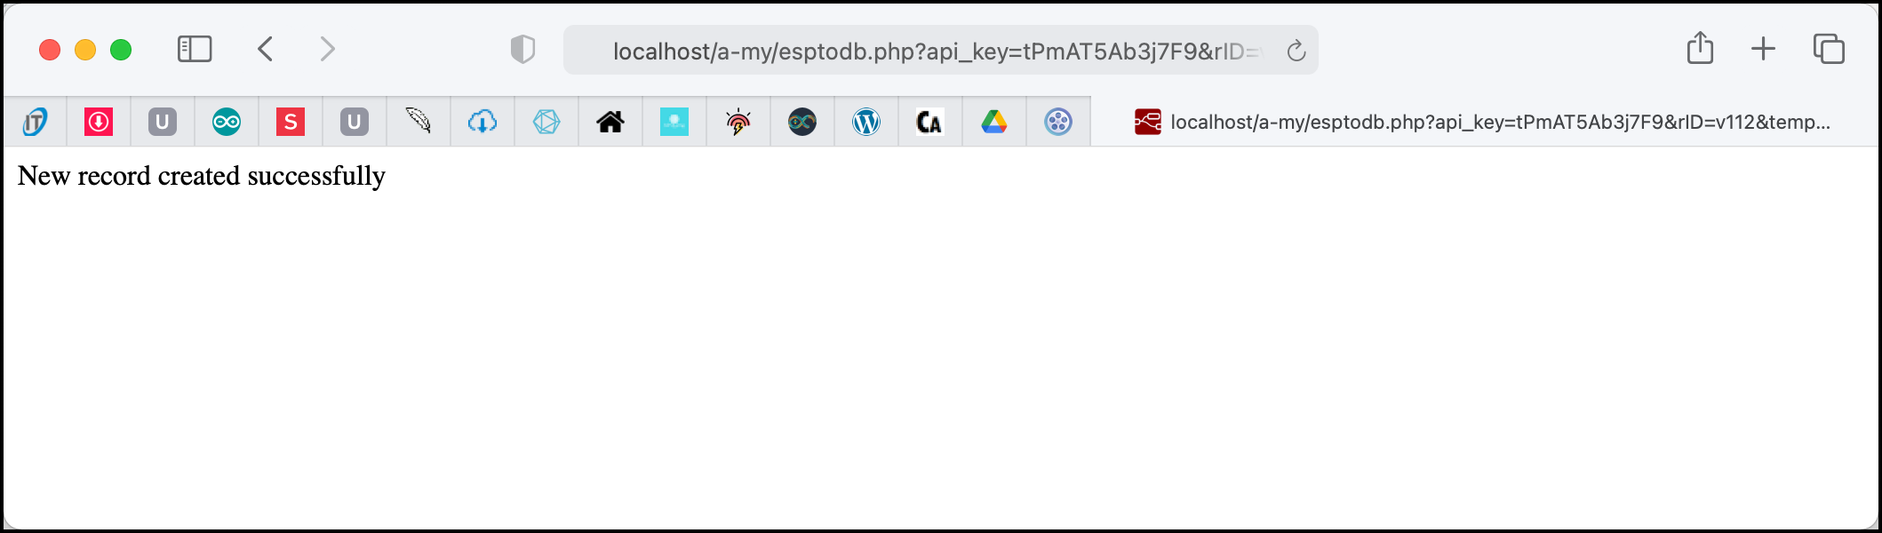
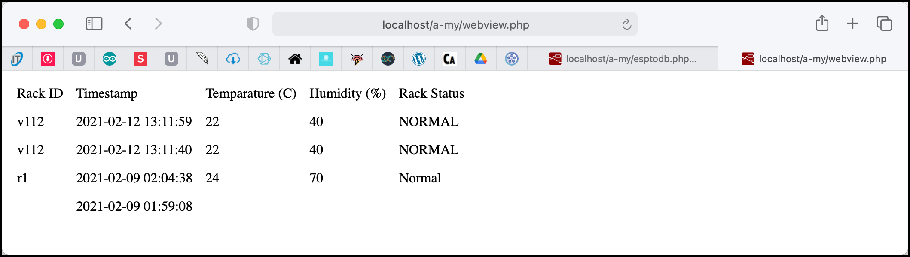
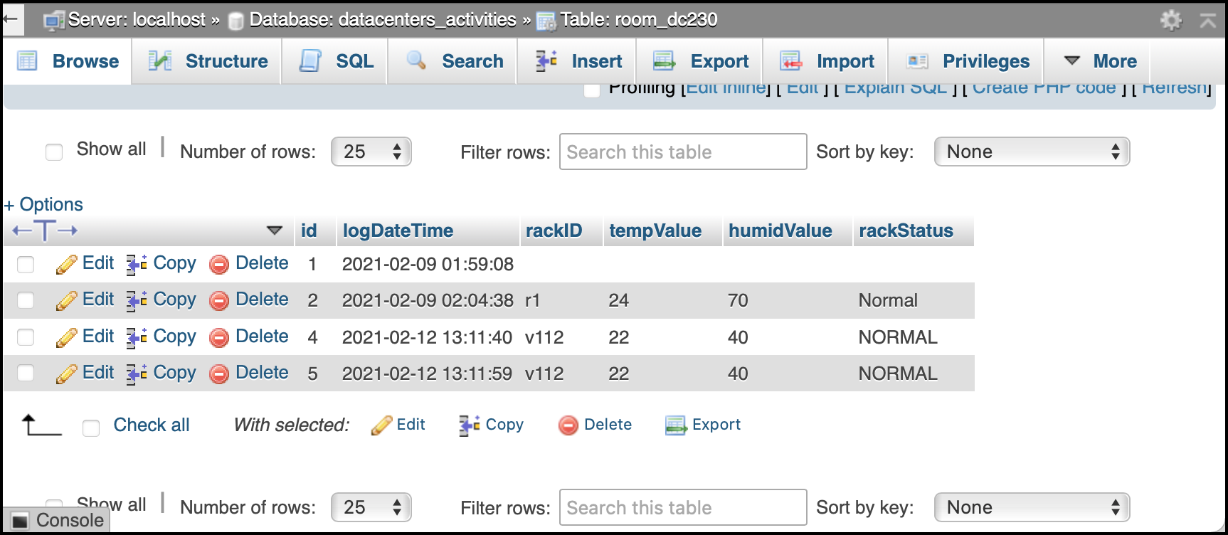
2d. Centralized Temperature & Humidity Monitoring System for Server Racks
Solution: Step 4
PHP SCRIPTS & HTDOCS & CODE EXPLAINATION & RUN TEST
→ Open a browser, then copy & paste the following link & press enter.
http://localhost/a-my/esptodb.php?api_key=tPmAT5Ab3j7F9&rID=v112&temp=22&humid=40&currentStat=NORMAL
→ Try this:
1- http://localhost/a-my/
2- http://localhost/a-my/esptodb.php?api_key=tpMAT5Ab3j7F9&rID=v111&temp=22.4&humid=40%&currentStat=“NORMAL”
Rev01 JAN2021

Slide 39
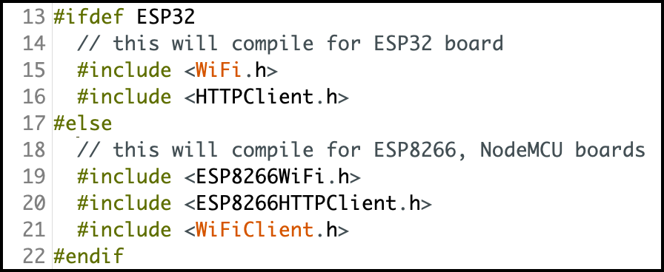
2d. Centralized Temperature & Humidity Monitoring System for Server Racks
Solution: Step 5
ESP32 POST INFORMATION TO DBASE: SKETCH WALKTHROUGH
→ Open sketch-v_esp32-dht11-http-post.ino from http://bit.ly/3p2pmNd downloaded in Step 4. Do not upload the sketch since you need to make some changes.
→ This will inform the compiler to compile the correct library no matter if what board you are currently uploading into. In this case, either ESP32 or NodeMCU & ESP8266.
Rev01 JAN2021

Slide 40
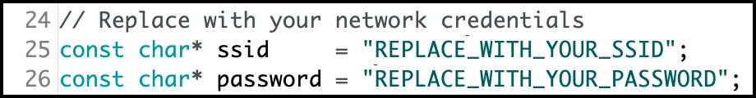

2d. Centralized Temperature & Humidity Monitoring System for Server Racks
Solution: Step 5
ESP32 POST INFORMATION TO DBASE: SKETCH WALKTHROUGH
→ Set the followings to the WiFi network connection.
→ Change the “192.168.1.102” with your server’s IP address. How to find IP address of your system ☺?
→ The file path “/a-my/esptodb.php” reflects the “drive/xampp/htdocs/” & set in STEP xx.
→ Both ESP32 has the same API key with esptodb.php to avoid fake request. If not match, the information will not save into database. The API key is manually generated by the developer/user.
→ Set the sensorID accordingly – e.g. rackID. This ID must be different from one another & must be documented, easier to detect & locate.
Rev01 JAN2021

Slide 41
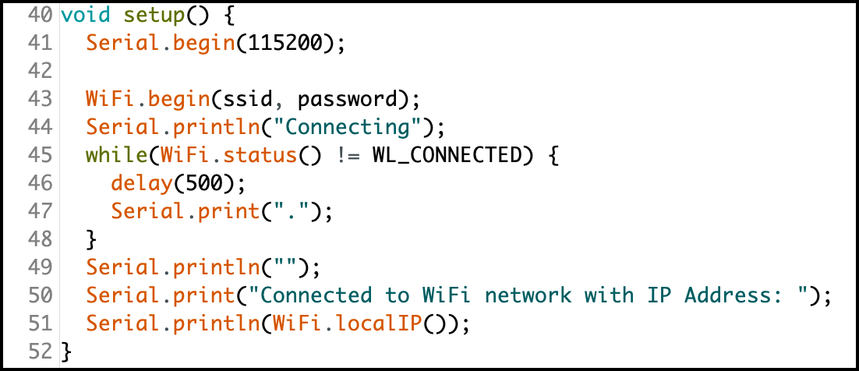
2d. Centralized Temperature & Humidity Monitoring System for Server Racks
Solution: Step 5
ESP32 POST INFORMATION TO DBASE: SKETCH WALKTHROUGH
→ The board will connect to the WiFi router. If any of the SSID or Password is incorrect, the board will not to join the network. Open Serial Monitor to view the process. IP address will be published if the board connected to the router.
→ Fail to connect to router.
Rev01 JAN2021

Slide 42
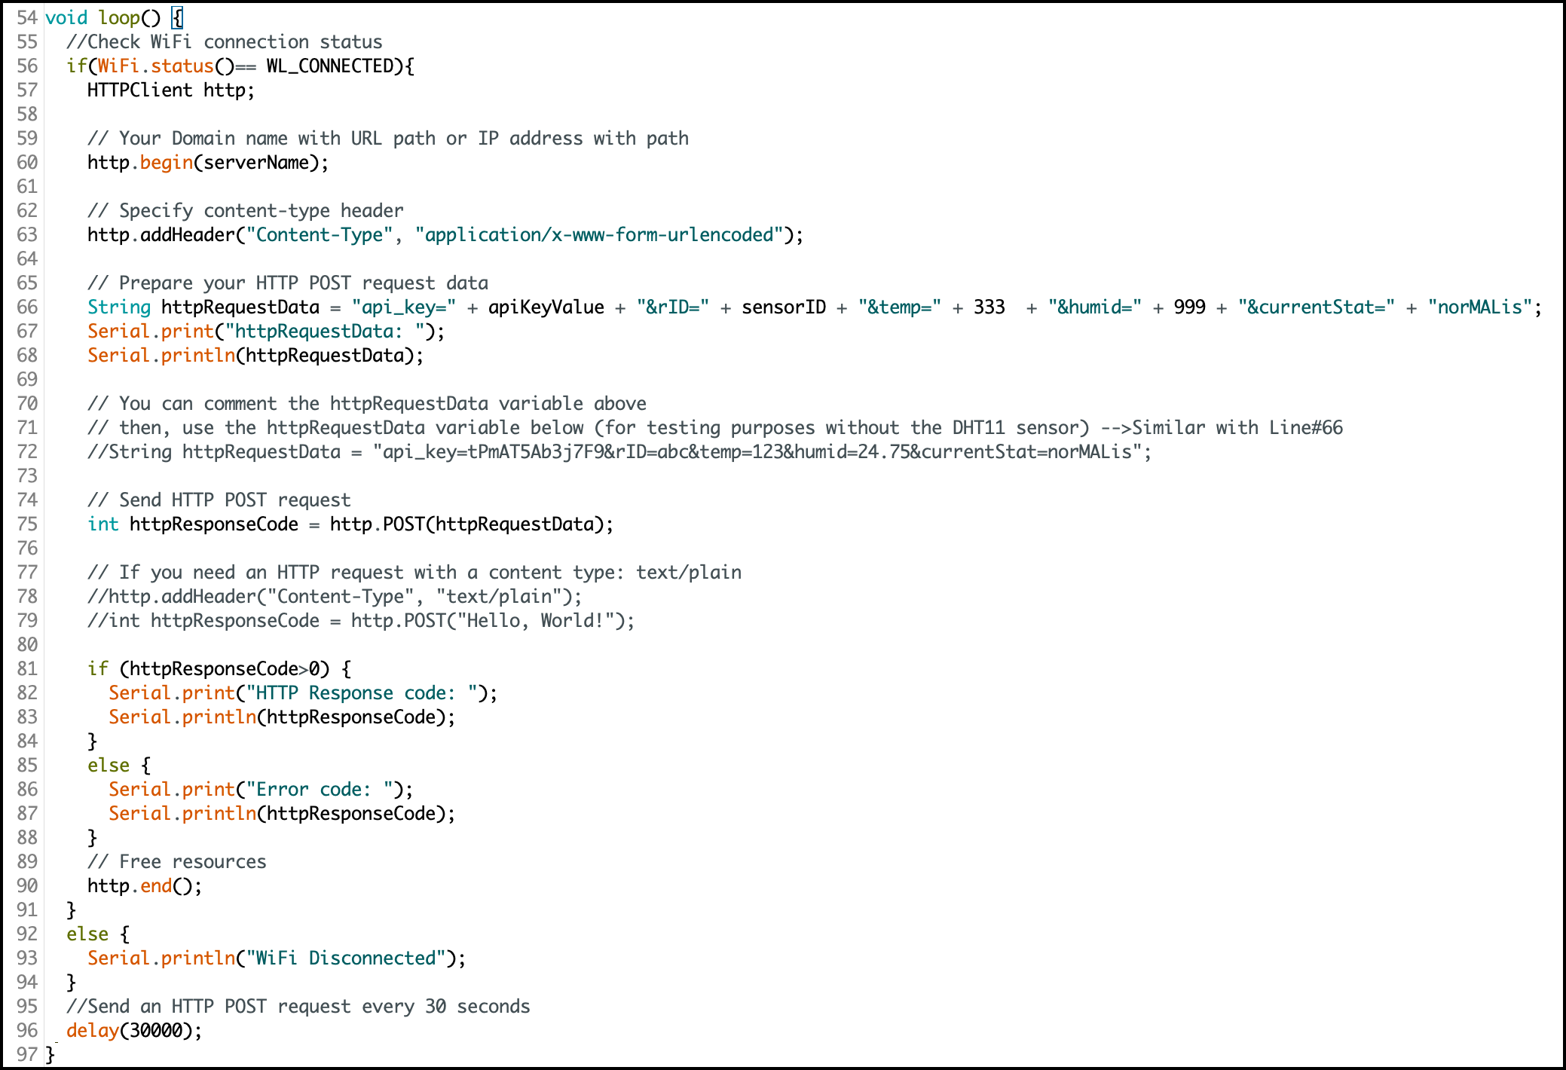
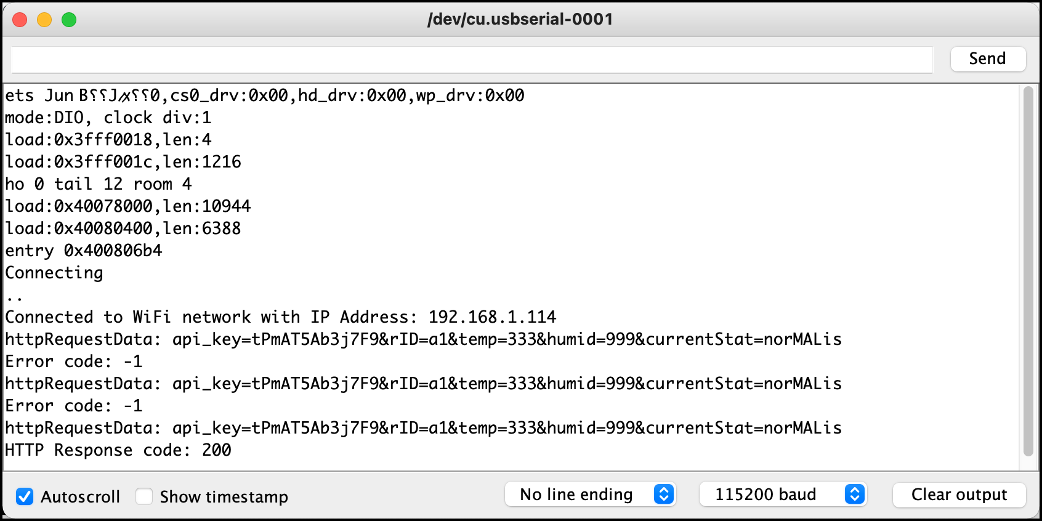
2d. Centralized Temperature & Humidity Monitoring System for Server Racks
Solution: Step 5
ESP32 POST INFORMATION TO DBASE: SKETCH WALKTHROUGH
#66: Test send data to esptodb.php (IP add at #29)
#81: Success to communicate with server
#85: Unable to communicate with server --> not in the same network
#96: Update every 30 seconds
#47
#50
#51
→ Fail to connect to router.
#67
#68
#86
#87
#82
#83
Rev01 JAN2021

Slide 43
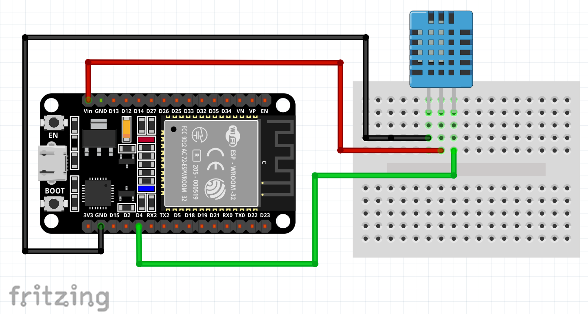

2d. Centralized Temperature & Humidity Monitoring System for Server Racks
Solution: Step 6
SCHEMATIC DIAGRAM
→ After success tested the skech, its time to combine the DHT part with ESP32.
→ Before we go any further, construct the circuit as in the figure.
→ Check a few times, the connections that have been made before plugging ESP32 to USB port. This might prevent short circuit to DHT11. Watch out on sensors’ pin. Same type, doesn’t mean same pin configurations.
GND
Vin
Signal D4
Rev01 JAN2021

Slide 44
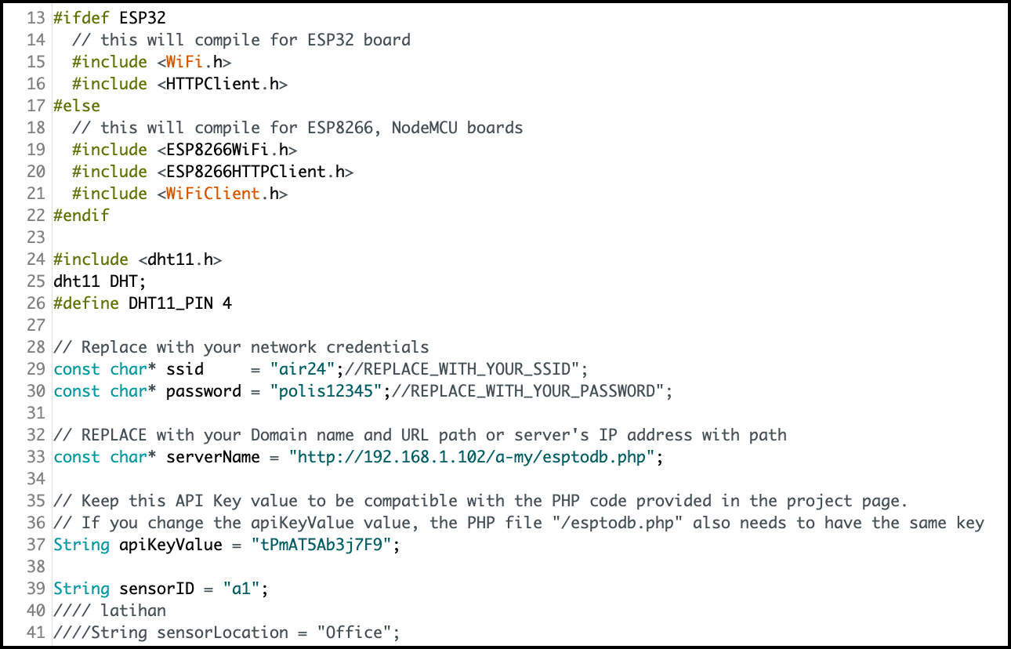
2d. Centralized Temperature & Humidity Monitoring System for Server Racks
Solution: Step 7
THE WORKING SKETCH
→ Open sketch-vii_esp32-dht11-http-post.ino from http://bit.ly/3p2pmNd downloaded in Step 4. Do not upload the sketch since you need to make some changes.
Rev01 JAN2021

Slide 45
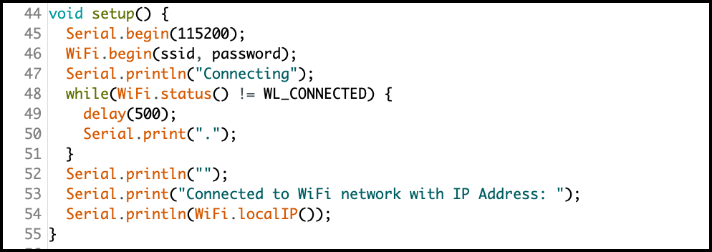
2d. Centralized Temperature & Humidity Monitoring System for Server Racks
Solution: Step 7
THE WORKING SKETCH
Rev01 JAN2021

Slide 46

2d. Centralized Temperature & Humidity Monitoring System for Server Racks
Solution: Step 7
THE WORKING SKETCH
Rev01 JAN2021

Slide 47



2d. Centralized Temperature & Humidity Monitoring System for Server Racks
Solution: Step 7
THE WORKING SKETCH
Rev01 JAN2021

Slide 48
2d. Centralized Temperature & Humidity Monitoring System for Server Racks
Solution: Step 7
THE WORKING SKETCH
Rev01 JAN2021

Slide 49
2d. Monitoring Data Center Temperature & Humidity Level
QUESTIONS?
Questions?
Rev01 JAN2021

Slide 50
2d. Monitoring Data Center Temperature & Humidity Level
EXERCISE
Modify this project by doing the followings:
Add LED statement in ESP32 sketch – if connected to WiFi, built in led (GPIO2) will switch on.
Write condition statements at PHP files:
If temp > 30˚C status is ALERT
If temp > 40˚C status is DANGER
The status need to be saved in the database together with other information.
HINT: you need to omit the status information from ESP32 skech.
Rev01 JAN2021

